Slide 1

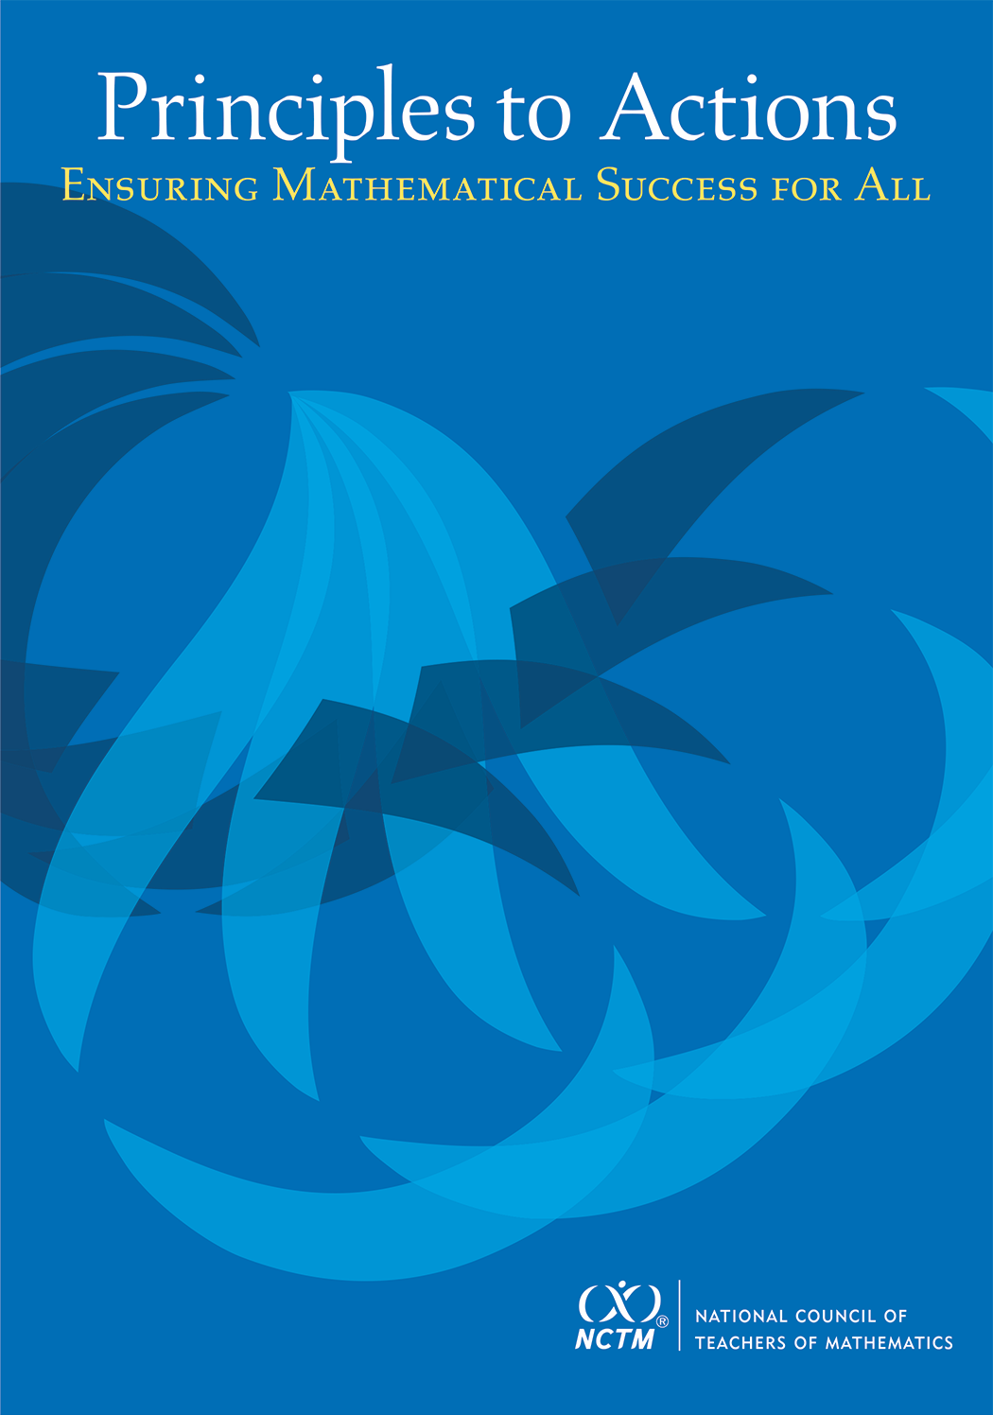
Warm-up Problem
A candy jar contains 5 Jolly Ranchers (squares) and 13 Jawbreakers (circles). Suppose you had a new candy jar with the same ratio of Jolly Ranchers to Jawbreakers, but it contained 100 Jolly Ranchers. How many Jawbreakers would you have? Explain how you know.
Please try to do this problem in as many ways as you can, both correct and incorrect.
If done, share your work with a neighbor or look at the solutions on the back of the handout.
Notes:
This session is intended to be an introduction to the Effective Teaching Practices in Principles to Actions: Ensuring Mathematical Success for All. It can be done in 1 hour with limited time for participant interaction. If you have more time, this session could easily be extended by engaging participants in some or all of the optional activities.
If time is limited, project the warm-up problem on the screen so that participants can work on it as they enter. Alternatively, if time permits you could engage participants in solving he task prior to reading the case of discussing the practices. This will take 30-45 minutes. The lesson plan (5-LessonPlan-CandyJarTask-MS-Donnelly) contains suggestions for conducting the lesson and sample solutions that may be helpful to you. You may want to provide participants with copies of the task (2-CandyJarTask-MS-Donnelly).

Slide 2
Principles to Actions:
Ensuring Mathematical Success
for All
A Focus on Effective Teaching Practices
Developed by Margaret Smith at the University of Pittsburgh. These materials are part of the Principles to Actions Professional Learning Toolkit: Teaching and Learning created by the team that includes: Victoria Bill (co-chair), Melissa Boston, Fredrick Dillon, Amy Hillen, DeAnn Huinker, Stephen Miller, Lynn Raith, Margaret Smith (chair), and Michael Steele.

Slide 3
Agenda
Discuss a new publication from NCTM that is intended to support implementation of CCSSM and other rigorous standards
Read and analyze a short case of a teacher (Mr. Donnelly) who is attempting to support his students’ learning
Discuss a set of eight teaching practices and relate them to the case
Consider ways to get started in making these practices central to your instruction
Notes:
Agenda
Introduction to Principles to Action - 5 minutes
Case of Mr. Donnelly - read individually and discuss briefly in small groups - 15 minutes
Present 8 teaching practices - 40 minutes
Consider ways to get started - 5 minutes
This introductory session can be done in 1 hour. It can easily be extended to 1.5 or 2 hours by providing participants with time to report out what they noticed about the case and by giving participants time to turn and talk about each of the questions posed related to the 8 practices.

Slide 4
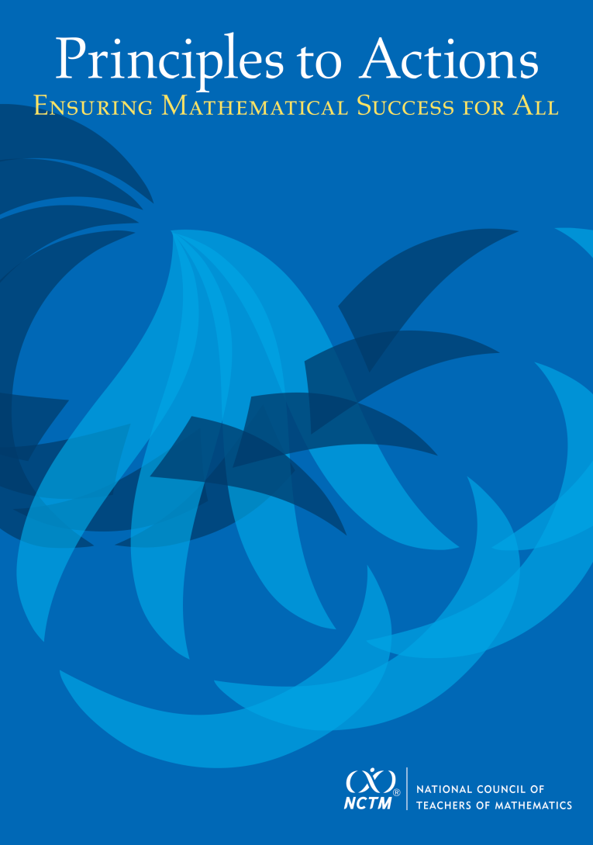
Principles to Actions:
Ensuring Mathematical Success for All
The primary purpose of PtA is to fill the gap between the adoption of rigorous standards and the enactment of practices, policies, programs, and actions required for successful implementation of those standards.
Notes:
We all know that the Common Core State Standards provides content expectations for student learning, but it does not tell us—as teachers—what to do at the classroom level to ensure that students learn mathematics.
This document provides guidance on what it will take to turn the opportunity of the Common Core into a reality in classrooms, schools, and districts and support mathematical success for all students.

Slide 5
Guiding Principles
for School Mathematics
Teaching and Learning
Access and Equity
Curriculum
Tools and Technology
Assessment
Professionalism
Essential Elements
of Effective Math
Programs
Notes:
These principles, while building on the 2000 PSSM work, \reflect more than a decade of experience and new research evidence about mathematics teaching and learning.

Slide 6
Guiding Principles
for School Mathematics
Teaching and Learning
Access and Equity
Curriculum
Tools and Technology
Assessment
Professionalism
Essential Elements
of Effective Math
Programs
Notes:
Our focus in this session in on the teaching and learning principle.

Slide 7
Principle on Teaching and Learning
An excellent mathematics program requires effective teaching that engages students in meaningful learning through individual and collaborative experiences that promote their ability to make sense of mathematical ideas and reason mathematically.

Slide 8
Guiding Principles
for School Mathematics
Effective teaching is the non-negotiable core that ensures that all students learn mathematics at high levels.

Slide 9
We Must Focus on Instruction
Student learning of mathematics “depends fundamentally on what happens inside the classroom as teachers and learners interact over the curriculum.”
(Ball & Forzani, 2011, p. 17)
“Teaching has 6 to 10 times as much impact on achievement as all other factors combined ... Just three years of effective teaching accounts on average for an improvement of 35 to 50 percentile points.”
Schmoker (2006, p. 9)

Slide 10
The Case of Mr. Donnelly
Read the Case of Mr. Donnelly and study the strategies used by his students.
Make note of what Mr. Donnelly did before or during instruction to support his students’ learning and understanding of proportional relationships.
Talk with a neighbor about the actions and interactions that you identified as supporting student learning.
Notes:
Handout 3-NarrativeCase-English-MS-Donnelly (Note the narrative is also available in Spanish)
We will be using the Case of Mr. Donnelly to ground our discussion of the mathematics teaching practices that are at the heart of Principles to Actions.
Mr. Donnelly used the Candy Jar task with his seventh grade students to explore proportional relationships. The case presents an excerpt from his classroom in which he and his students were discussing and analyzing the various strategies students used in working on the Candy Jar task.
IF you have time and your group is small, you could chart what teachers came up with in their discussions. You could then refer back to these later when discussing the practices and use the P2A labels for the actions/interactions teachers identified.

Slide 11
Effective
Mathematics Teaching Practices
Establish mathematics goals to focus learning.
Implement tasks that promote reasoning and problem solving.
Use and connect mathematical representations.
Facilitate meaningful mathematical discourse.
Pose purposeful questions.
Build procedural fluency from conceptual understanding.
Support productive struggle in learning mathematics.
Elicit and use evidence of student thinking.
Notes:
Handout 4-EffectiveMathematicsTeachingPractices-MS-Donnelly
At the heart of the teaching and learning principle is a set of eight teaching practices.
This research-informed framework of teaching and learning reflects the knowledge that has accumulated over the last two decades. It represents what we see as a core set of practices and essential teaching skills necessary to promote deep learning of mathematics.
We are going to go through each of these in more detail and relate each to the Case of Mr. Donnelly.

Slide 12
Establish Mathematics Goals
To Focus Learning
Learning Goals should:
Clearly state what it is students are to learn and understand about mathematics as the result of instruction;
Be situated within learning progressions; and
Frame the decisions that teachers make during a lesson.
Formulating clear, explicit learning goals sets the stage for everything else.
(Hiebert, Morris, Berk, & Janssen, 2007, p.57)
Notes:
It is important to note that a learning goal is different that an objective. As teachers, we often state objectives in terms of SWBAT – which focuses on what students will DO rather than what they will learn as a result of engaging in a particular activity.
Our focus in this practice is on what students will learn.

Slide 13
Goals to Focus Learning
Mr. Donnelly’s goal for students’ learning:
  Students will recognize that quantities that are in a proportional (multiplicative) relationship grow at a constant rate.
How does his goal align with this teaching practice?
Notes:
IF you have time you could give participants time to turn about talk about these questions and report out if possible.
Mr. Donnelly was clear about the mathematics that students would learn (Lines 1-3)
His goal was grade-level appropriate and consistent with recommendations from CCSS (slides 37-38).
His lesson built on the work they had done previously (prior knowledge (lines 13-15).
He made decisions through out the lesson based on his goal
He invited students to present who had recognized the multiplicative relationship between candies (groups 2 and 5) and focusing on the multiplication by different factors (lines 49-50).
He invited students to share unit rate strategy (group 2) and scale factor strategy (group 3 and 5)
He gave students the exit slip at the end of class that provided an opportunity for each student to demonstrate their understanding that ratios needed to grow at a constant rate (lines 77-79).

Slide 14
Implement Tasks that Promote
Reasoning and Problem Solving
Mathematical tasks should:
Provide opportunities for students to engage in exploration or encourage students to use procedures in ways that are connected to concepts and understanding;
Build on students’ current understanding; and
Have multiple entry points.
There is no decision that teachers make that has a greater impact on students’ opportunities to learn and on their perceptions about what mathematics is than the selection or creation of the tasks with which the teacher engages students in studying mathematics.
Lappan & Briars, 1995
Notes:
Last bullet - make the point that this is an issue of equity. Students need to have access to the task.
These types of tasks have been referred to as cognitively demanding or high-level both of which emphasize the kind of thinking that is required to solve them.

Slide 15
Tasks that Promote
Reasoning and Problem Solving
How is Mr. Donnelly’s task (Candy Jar) similar to or different from the Missing Value problem?
Which one is more likely to promote problem solving?
Notes:
IF you have time you could give participants time to turn about talk about these questions and report out if possible.
Same
Content
Both could be solved using cross multiplication
Different
Multiple ways to enter Candy Jar – picture, build model, make table
Multiple ways to solve CJ – scale factor, scaling up, unit rate
No implied way of solving CJ
Where the task could be used – beginning of a unit vs practicing a procedure
The Candy Jar task is likely to promote reasoning and problem solving for the following reasons:
There are multiple ways to enter the task– draw a picture, build a model, make a table
There are multiple ways to solve the task – scale factor, scaling up, unit rate
There is no implied way of solving task (assuming that cross multiplication has not been taught or that a specific method has been demonstrated)
The context of the problem (candy jars) can help students in making sense of what the numbers they come up with actually mean.

Slide 16






Tasks that Promote
Reasoning and Problem Solving
How is Mr. Donnelly’s task (Candy Jar) similar to or different from the Missing Value problem?
Which one is more likely to promote problem solving?
Finding the Missing Value
Find the value of the unknown in each of the proportions shown below.

Slide 17
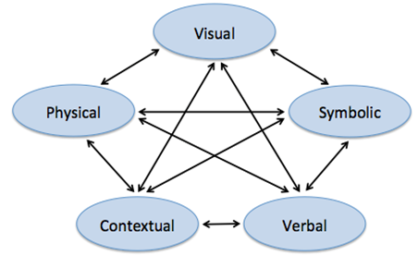
Use and Connect
Mathematical Representations
Different Representations should:
Be introduced, discussed, and connected;
Focus students’ attention on the structure or essential features of mathematical ideas; and
Support students’ ability to justify and explain their reasoning.
Strengthening the ability to move between and among these representations improves the growth of children’s concepts.
Lesh, Post, Behr, 1987
Notes:
The key here isn’t just being able to work in each representation but to be able to make connections between them with different starting points.

Slide 18
Connecting Representations
What different representations were used and connected in Mr. Donnelly’s class?
How might his students benefit from making these connections?
Notes:
IF you have time you could give participants time to turn about talk about these questions and report out if possible.
Multiple representations -- the context, symbolic strategies, and a table -- were used by students to make sense of mathematics.
Context was used repeatedly in the discussion of the problem: students consistently made reference to the JR and JB; Mr. D. talks about wanting students to see that the scale factor (line 29-31) is the number of small candy jars that it would take to make the new candy jar. This was never a naked number problem for students. The symbolic representation continued to be connected to the context.
Students’ use of the table was connected to the symbolic strategies of unit rate (lines 61-65) and scale factor (lines 31-33).
HOW BENEFIT?
Students see that different approaches and representations are related.
It expands their repertoire of ways to approach problems
Develops their flexibility

Slide 19
Facilitate
Meaningful Mathematical Discourse
Mathematical Discourse should:
Build on and honor students’ thinking;
Provide students with the opportunity to share ideas, clarify understandings, and develop convincing arguments; and
Advance the mathematical learning of the whole class.
Discussions that focus on cognitively challenging mathematical tasks, namely those that promote thinking, reasoning, and problem solving, are a primary mechanism for promoting conceptual understanding of mathematics (Hatano & Inagaki, 1991; Michaels, O’Connor, & Resnick, 2008).
Smith, Hughes, Engle & Stein, 2009, p. 549
Notes:
Need a task that is worth talking about!
Explain that cognitively challenging tasks -- referred to in the quote -- are ones that promote thinking, reasoning and problem solving.

Slide 20
Meaningful Discourse
What did Mr. Donnelly do (before or during the discussion) that may have positioned him to engage his students in a productive discussion?
Notes:
IF you have time you could give participants time to turn about talk about these questions and report out if possible.
Mr. Donnelly engaged many students during the discussion and the students were pressed to make sense of and debated the ideas put forth by their peers.
The teacher made salient difference between students’ solution paths and asked students to talk about the differences (lines 49 - 50).
The teacher asked students to agree or disagree with each other’s reasoning. (line 55).
The teacher helped students make connections between different strategies and to the key mathematical ideas in the lesson (lines 29-33).
The teacher encouraged students to ask questions of each other (line 42).
The teacher poses a challenging question and then gives students time to talk to their partners before engaging the whole group in a discussion (lines 61-62; 70-71).

Slide 21

5 Practices
Anticipating
Monitoring
Selecting
Sequencing
Connecting
5 Practices for Orchestrating
Productive
Mathematics
Discussions
Notes:
The 5 practices are meant to make student-centered instruction more manageable by moderating the degree of improvisation required by the teacher during a discussion.
Rather than focusing on in-the-moment responses to students contributions, the practices instead emphasize the importance of planning. Through planning, teachers can anticipate likely student contributions, prepare responses they might make to them, and make decisions about how to structure students’ presentations to further their mathematical agenda for the lesson.
We can see evidence of the teacher engaging in practices 2-5 and although there is no direct evidence that he engaged in ANTICIPATING it is unlikely that she could have engaged in any of the other practices had he not anticipated first.

Slide 22
Pose Purposeful Questions
Effective Questions should:
Reveal students’ current understandings;
Encourage students to explain, elaborate, or clarify their thinking; and
Make the mathematics more visible and accessible for student examination and discussion.
Teachers’ questions are crucial in helping students make connections and learn important mathematics and science concepts. Teachers need to know how students typically think about particular concepts, how to determine what a particular student or group of students thinks about those ideas, and how to help students deepen their understanding.
Weiss & Pasley, 2004
Notes:
Teachers need to know what students think so they can guide thinking in a productive direction.
Questions are one of the only tools we have that gets us inside students heads!

Slide 23
Purposeful Questions
What did you notice about the questions that Mr. Donnelly asked on lines 38-71?
What purpose did the questions serve?
Notes:
IF you have time you could give participants time to turn about talk about these questions and report out if possible.
The questions the teacher asked were very open – they required students to think and explain. Specifically, the questions the teacher asked:
Made students thinking visible (lines 41; 63-65)
Engaged students in exploring mathematics (lines 63; 71-72)
Invited others to participate (lines 42; 55)
Helped students make connections (lines 61-62) and compare approaches (lines 49-50)

Slide 24
Build Procedural Fluency from Conceptual Understanding
Procedural Fluency should:
Build on a foundation of conceptual understanding;
Result in generalized methods for solving problems; and
Enable students to flexibly choose among methods to solve contextual and mathematical problems.
Students must be able to do much more than carry out mathematical procedures. They must know which procedure is appropriate and most productive in a given situation, what a procedure accomplishes, and what kind of results to expect. Mechanical execution of procedures without understanding their mathematical basis often leads to bizarre results.
Martin, 2009, p. 165
Notes:
Fluency is not intended as the main or sole target of instruction. Problem Solving and Reasoning that are the focus of the second teaching practice need to co-exit with procedural fluency. This occurs when students first have the opportunity to develop conceptual understanding.
NO more mindless use of procedures.

Slide 25

Procedural Fluency
What might we expect the students in Mr. Donnelly’s class to be able to do when presented with a missing value problem, after they have had the opportunity to develop a set of strategies through solving a variety of contextual problems like the Candy Jar Task?
Notes:
IF you have time you could give participants time to turn about talk about these questions and report out if possible.
If students are given naked number problems AFTER they have developed rich strategies for solving missing value problems, we might expect that they will reason through such problems in a way similar to how they thought about the candy jar and related problems using scaling up, scale factor, and unit rate in ways that made sense to them (see slides 26-27).
Additional Exploration: In the folder labeled “additional explorations” there is an article Article-FlucneyandUnderstanding. This article provide more detail on how to build the understanding of a procedure (cross multiplication) by building on students intuitive strategies. The task that is used in the article is the candy jar task. You may want to have teachers read and discuss the article in order to explore the relationship between conceptual understanding and procedural fluency more deeply.

Slide 26
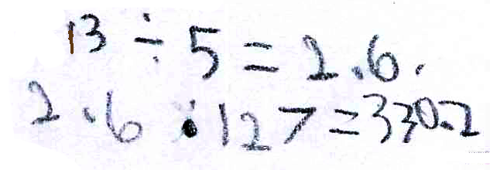
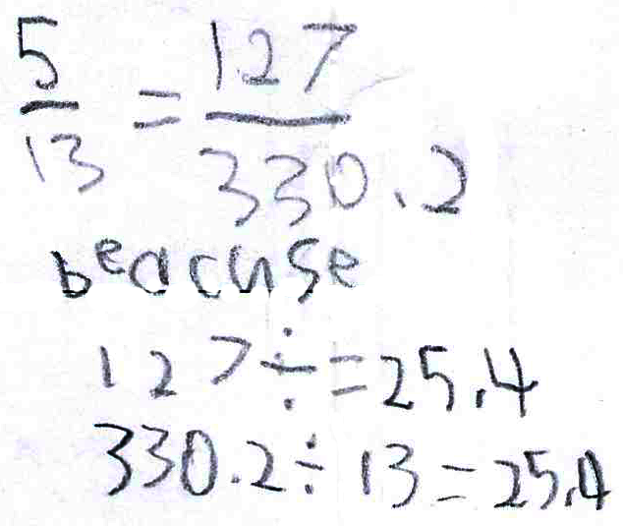
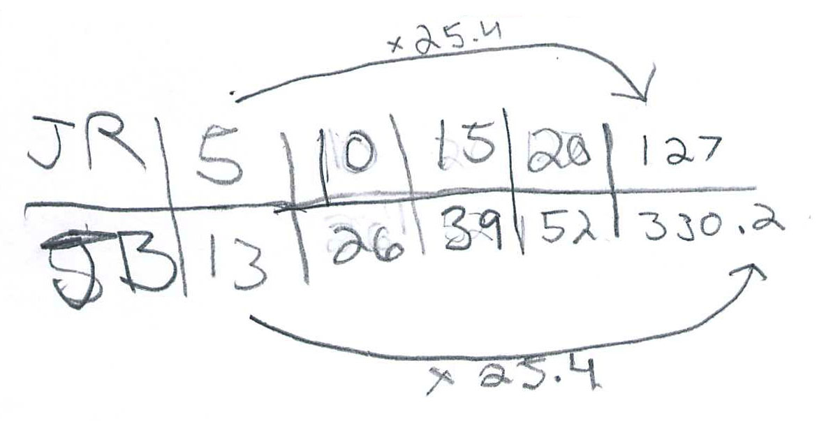
Procedural Fluency
Notes:
Take a minute and look at the work a group of students produced. They had not been taught cross multiplication but HAD done problems that allowed them to develop a range of strategies.

Slide 27
Procedural Fluency
Unit Rate
Scale Factor
Scaling Up
Notes:
So the strategies that they learned were flexible and generalizable and they were able to apply them in ways that made sense.

Slide 28
Support Productive Struggle
in Learning Mathematics
Productive Struggle should:
Be considered essential to learning mathematics with understanding;
Develop students’ capacity to persevere in the face of challenge; and
Help students realize that they are capable of doing well in mathematics with effort.
By struggling with important mathematics we mean the opposite of simply being presented information to be memorized or being asked only to practice what has been demonstrated.
Hiebert & Grouws, 2007, pp. 387-388
Notes:
We are not talking about giving students impossible problems to.
Students need to be able to figure things out for themselves…it is through this process of figuring things own that they will develop authority and ownership of their own learning.

Slide 29
Productive Struggle
How did Mr. Donnelly support students when they struggled?
What would have happened if he had been more directive with his students?
Notes:
IF you have time you could give participants time to turn about talk about these questions and report out if possible.
Mr. Donnelly supported students’ ability to work through the problem without taking over the thinking for them and thereby lowering the demand of the task. In this way he set the message to students that they were capable of figuring it out for themselves. In the end students would have ownership of the work.
The teacher provided students with time to work on the task with other students in small groups (lines 10-12).
When students struggled, Mr. Donnelly encouraged students to look at the work they had done the previous day (lines 13-16).
The teacher asked questions as needed to help students make progress on the task (lines 10-15).
The teacher acknowledges and names a correct strategy – the marking serves as praise and signals a point in the lesson when the student can move forward (line 57-58).
The teacher concluded the lesson by asking students to make sense of the incorrect additive solution, indicating that the teacher did not tell students that this was wrong but left them with the tasking of figuring out why it would not work (lines 74-79).
Hence he supported students ability to work through the problem without taking over the thinking for them and thereby lowering the demand of the task. In this way he set the message to students that they were capable of figuring it out for themselves. In the end they would have ownership of the work.

Slide 30
Another Candy Jar Lesson
As students in Ms. Pascal’s sixth grade classroom began working with their partners on the first candy jar problem, she walked around the room stopping at different groups to listen in on their conversations. It soon became evident to Ms. Pascal that students were struggling to get started. She called the class together and reminded them of the table they had created the previous day in which they had generated ratios equivalent to 5 JRs to 13 JBs. She suggested that they might want to consider extending the table in order to find out how many JBs there would be when you had 100 JRs. Students returned to their partner work with renewed energy. As Ms. Pascal continued to monitor their progress, she noted that students were easily able to extend the table and arrive at the correct answer.
Notes:
Consider for a minute what occurred in Ms. Pascal’s classroom. IF you have time you could give participants time to turn about talk about these questions and report out if possible.
When students struggled, the teacher took over the thinking for them and told them exactly what to do. In the end students all got the same correct answer and used the same strategy – the one the teacher suggested.
What did Ms. Pascal’s students learn?
When a problem is hard the teacher will tell us what to do.
We need the teacher to figure things out.
There is one way to solve a problem and it is the teachers way.
I don’t need to understand why something works I just need to know how to get the right answer.
Additional Exploration: in the folder labeled “additional explorations” there is a more extended version of the Case of Sandra Pascal (SandraPascal-CandyJarTask). If time permits you might want to have teachers read the Case of Sandra Pascal and consider how Pascal and Donnelly are the same and how they are different, and why the differences might matter. The big distinction here is that Donnelly maintains the level of demand of the task thus preserving students opportunities to think and reason while Pascal does not. Specifically, Pascal takes over the thinking and reasoning leaving students to simply follow a procedure. When this occurs students learn less.

Slide 31
Elicit and Use Evidence
of Student Thinking
Evidence should:
Provide a window into students’ thinking;
Help the teacher determine the extent to which students are reaching the math learning goals; and
Be used to make instructional decisions during the lesson and to prepare for subsequent lessons.
Formative assessment is an essentially interactive process, in which the teacher can find out whether what has been taught has been learned, and if not, to do something about it. Day-to-day formative assessment is one of the most powerful ways of improving learning in the mathematics classroom.
Wiliam, 2007, pp. 1054; 1091
Notes:
Decisions about instruction should be based on what the students know and understand about mathematics. In order to determine what they know and understand, you have to make their thinking visible.
We could have called this formative assessment – that is what it is – but we think the use of the word assessment suggests a more formal process that obscures the focus on student thinking.

Slide 32
Evidence of Student Thinking
To what extent did Mr. Donnelly elicit students’ thinking?
To what extent did (or could) Mr. Donnelly use the evidence to inform his instruction?
Notes:
IF you have time you could give participants time to turn about talk about these questions and report out if possible.
Elicit
Gave them a task that required them to think and reason and explain. So the task help elicit student thinking. (6-8)
T asked questions throughout the lesson that focused on explaining what they knew, what they thought about solutions produced by others.
T gave a exit slip at the end of class that was intended to elicit their current understanding about the relationship between the candies. (74-79)
DO
Mr. Donnelly pays attention to the strategies students are using and plans a discussion that is based on student work (lines 18-22).
His entire lesson appears to unfold based on what he has learned about students thinking and understanding.
One would expect that his lesson the following day would be informed by what he learns from the exit slip.

Slide 33
“If your students are going home at the end of the day less tired than you are, the division of labor in your classroom requires some attention.”
Wiliam, D. (2011)

Slide 34
Getting Started
Learn more about the effective teaching practices from reading the book, exploring other resources, and talking with your colleagues and administrators.
Engage in observations and analysis of teaching (live or in narrative or video form) and discuss the extent to which the eight practices appear to have been utilized by the teacher and what impact they had on teaching and learning.
Co-plan lessons with colleagues using the eight effective teaching practices as a framework. Invite the math coach (if you have one) to participate.
Observe and debrief lessons with particular attention to what practices were used in the lesson and how the practices did or did not support students’ learning.
Notes:
In the TAKE ACTION section there are a list of actions for teachers and I encourage you to read them.
Here are some suggestions for getting started.

Slide 35
Thank You!

Slide 36
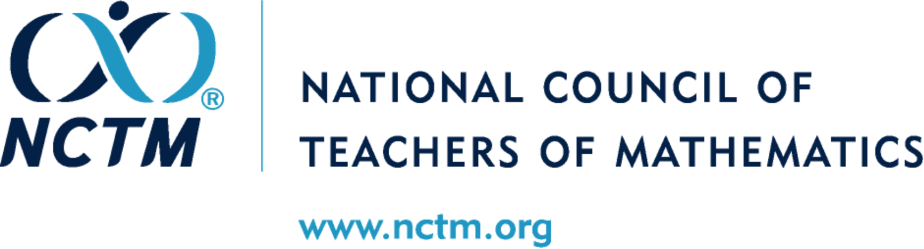

Slide 37
Candy Jar Task
Common Core State Standards 7.RP:
2. Recognize and represent proportional relationships between quantities.
Decide whether two quantities are in a proportional relationship, e.g., by testing for equivalent ratios in a table or graphing on a coordinate plane and observing whether the graph is a straight line through the origin.
Identify the constant of proportionality (unit rate) in tables, graphs, equations, diagrams, and verbal descriptions of proportional relationships.
Represent proportional relationships by equations. For example, if total cost t is proportional to the number n of items purchased at a constant price p, the relationship between the total cost and the number of items can be expressed as t = pn.
Explain what a point (x, y) on the graph of a proportional relationship means in terms of the situation, with special attention to the points (0, 0) and (1, r) where r is the unit rate.

Slide 38
Candy Jar Task
Common Core State Standards 7.RP:
2. Recognize and represent proportional relationships between quantities.
Decide whether two quantities are in a proportional relationship, e.g., by testing for equivalent ratios in a table or graphing on a coordinate plane and observing whether the graph is a straight line through the origin.
Identify the constant of proportionality (unit rate) in tables, graphs, equations, diagrams, and verbal descriptions of proportional relationships.
Represent proportional relationships by equations. For example, if total cost t is proportional to the number n of items purchased at a constant price p, the relationship between the total cost and the number of items can be expressed as t = pn.
Explain what a point (x, y) on the graph of a proportional relationship means in terms of the situation, with special attention to the points (0, 0) and (1, r) where r is the unit rate.

