Slide 1

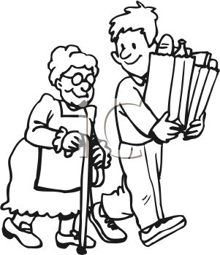
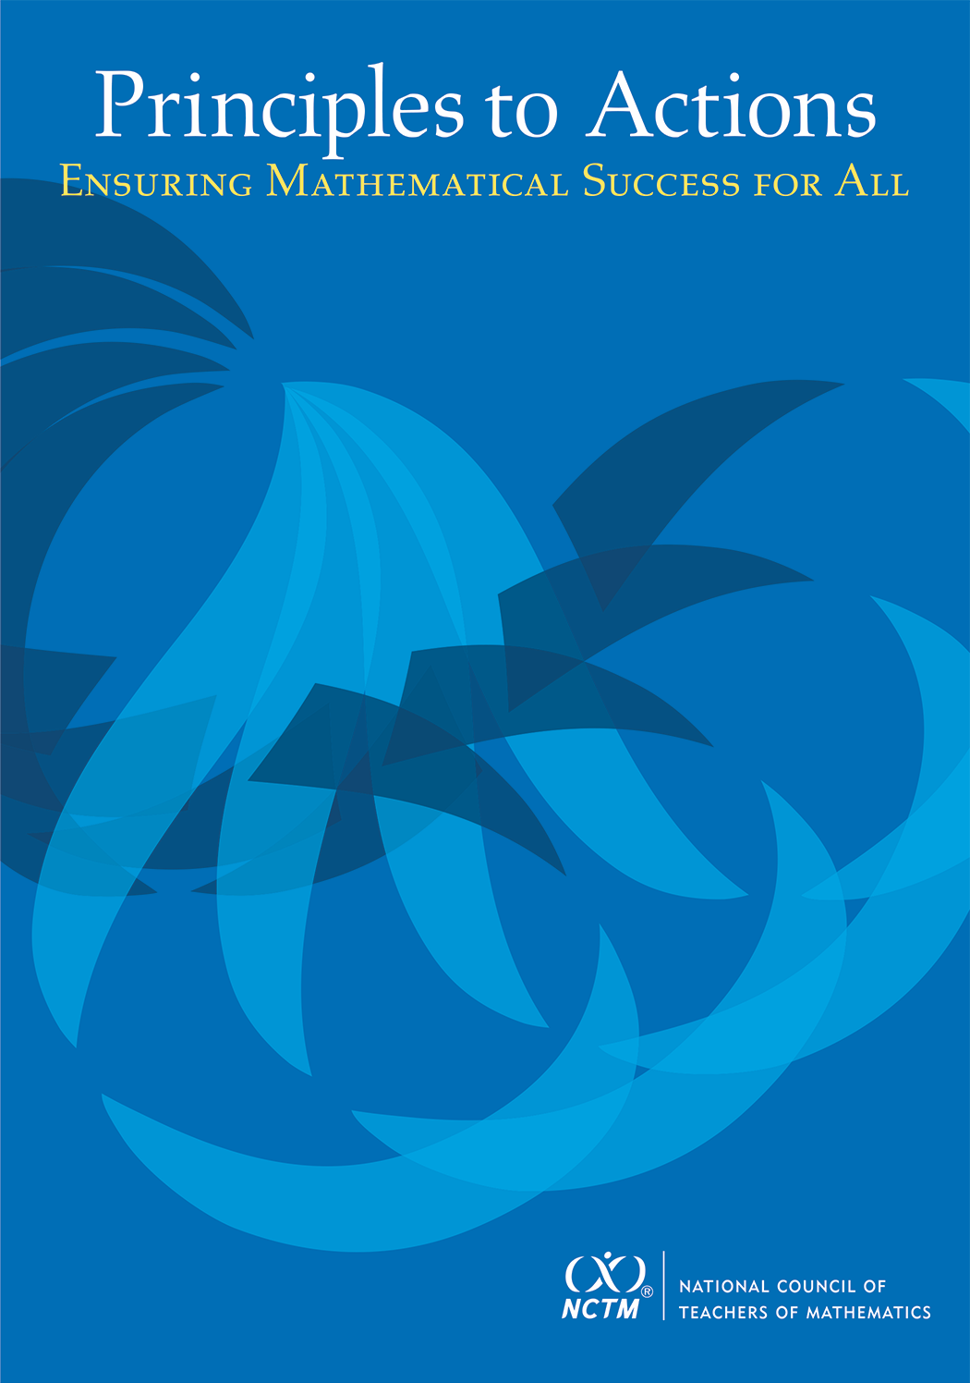
Warm-up Problem
In the movie “Pay It Forward,” a student, Trevor, comes up with an idea that he thought could change the world. He decides to do a good deed for three people and then each of the three people would do a good deed for three more people and so on. He believed that before long there would be good things happening to billions of people. At stage 1 of the process, Trevor completes three good deeds. How does the number of good deeds grow from stage to stage? How many good deeds would be completed at stage 5? Describe a function that would model the Pay It Forward process at any stage.
Please try to do this problem in as many ways as you can, both correct and incorrect.
If done, share your work with a neighbor or look at the solutions on the back of the handout.

Slide 2
Principles to Actions:
Ensuring Mathematical Success
for All
A Focus on Effective Teaching Practices

Slide 3
Agenda
Discuss a new publication from NCTM that is intended to support implementation of CCSSM and other rigorous standards
Read and analyze a short case of a teacher (Ms. Culver) who is attempting to support her students’ learning
Discuss a set of eight teaching practices and relate them to the case
Discuss how to get started in making these practices central to your instruction

Slide 4

Principles to Actions:
Ensuring Mathematical Success for All
The primary purpose of PtA is to fill the gap between the adoption of rigorous standards and the enactment of practices, policies, programs, and actions required for successful implementation of those standards.

Slide 5
Guiding Principles
for School Mathematics
Teaching and Learning
Access and Equity
Curriculum
Tools and Technology
Assessment
Professionalism
Essential Elements
of Effective Math
Programs

Slide 6
Guiding Principles
for School Mathematics
Teaching and Learning
Access and Equity
Curriculum
Tools and Technology
Assessment
Professionalism
Essential Elements
of Effective Math
Programs

Slide 7
Principle on Teaching and Learning
An excellent mathematics program requires effective teaching that engages students in meaningful learning through individual and collaborative experiences that promote their ability to make sense of mathematical ideas and reason mathematically.

Slide 8
Guiding Principles
for School Mathematics
Effective teaching is the non-negotiable core that ensures that all students learn mathematics at high levels.

Slide 9
We Must Focus on Instruction
Student learning of mathematics “depends fundamentally on what happens inside the classroom as teachers and learners interact over the curriculum.”
(Ball and Forzani 2011, p. 17)
“Teaching has 6 to 10 times as much impact on achievement as all other factors combined. ... Just three years of effective teaching accounts on average for an improvement of 35 to 50 percentile points.”
(Schmoker 2006, p. 9)

Slide 10
The Case of Ms. Culver
Read the Case of Ms. Culver and study the strategies used by her students.
Make note of what Ms. Culver did before or during instruction to support her students’ learning and understanding of exponential relationships.
Talk with a neighbor about the actions and interactions that you identified as supporting student learning.

Slide 11
Effective
Mathematics Teaching Practices
Establish mathematics goals to focus learning.
Implement tasks that promote reasoning and problem solving.
Use and connect mathematical representations.
Facilitate meaningful mathematical discourse.
Pose purposeful questions.
Build procedural fluency from conceptual understanding.
Support productive struggle in learning mathematics.
Elicit and use evidence of student thinking.

Slide 12
Establish Mathematics Goals
To Focus Learning
Learning Goals should:
Clearly state what it is students are to learn and understand about mathematics as the result of instruction;
Be situated within learning progressions; and
Frame the decisions that teachers make during a lesson.
Formulating clear, explicit learning goals sets the stage for everything else.
(Hiebert, Morris, Berk, and Janssen 2007, p. 57)

Slide 13
Goals to Focus Learning
Ms. Culver’s goal for students’ learning:
  Students will understand that exponential functions grow by equal factors over equal intervals and that in the general equation
  y = b^{x}, the exponent (x) tells you how many times to use the base (b) as a factor.
How does her goal align with this teaching practice?

Slide 14
Implement Tasks that Promote
Reasoning and Problem Solving
Mathematical tasks should:
Provide opportunities for students to engage in exploration or encourage students to use procedures in ways that are connected to concepts and understanding;
Build on students’ current understanding; and
Have multiple entry points.
There is no decision that teachers make that has a greater impact on students’ opportunities to learn and on their perceptions about what mathematics is than the selection or creation of the tasks with which the teacher engages students in studying mathematics.
(Lappan and Briars 1995)

Slide 15
Tasks that Promote
Reasoning and Problem Solving
How is Ms. Culver’s task (Pay It Forward) similar to or different from the Missing Value problem?
Which one is more likely to promote problem solving?

Slide 16
Tasks that Promote
Reasoning and Problem Solving
How is Ms. Culver’s task (Pay It Forward) similar to or different from the Petoskey Population problem?
Which one is more likely to promote problem solving?
Petoskey Population
The population of Petoskey, Michigan, was 6,076 in 1990 and was growing at the rate of 3.7% per year. The city planners want to know what the population will be in the year 2025. Write and evaluate an expression to estimate this population.
Notes:
6076 (1.037)^{t}
21,671
Algebra 2
Holt, Rinehart and Winston, 2004
Page 415

Slide 17
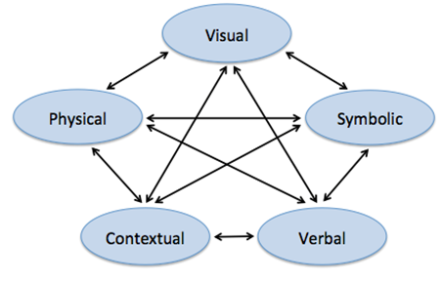
Use and Connect
Mathematical Representations
Different Representations should:
Be introduced, discussed, and connected;
Focus students’ attention on the structure or essential features of mathematical ideas; and
Support students’ ability to justify and explain their reasoning.
Strengthening the ability to move between and among these representations improves the growth of children’s concepts.
(Lesh, Post and Behr 1987)

Slide 18
Connecting Representations
What different representations were used and connected in Ms. Culver’s class?
How might her students benefit from making these connections?

Slide 19
Facilitate
Meaningful Mathematical Discourse
Mathematical Discourse should:
Build on and honor students’ thinking;
Provide students with the opportunity to share ideas, clarify understandings, and develop convincing arguments; and
Advance the mathematical learning of the whole class.
Discussions that focus on cognitively challenging mathematical tasks, namely those that promote thinking, reasoning, and problem solving, are a primary mechanism for promoting conceptual understanding of mathematics (Hatano and Inagaki 1991; Michaels, O’Connor and Resnick 2008).
(Smith, Hughes, Engle and Stein 2009, p. 549)

Slide 20
Meaningful Discourse
What did Ms. Culver do (before or during the discussion) that may have positioned her to engage her students in a productive discussion?

Slide 21
Pose Purposeful Questions
Effective Questions should:
Reveal students’ current understandings;
Encourage students to explain, elaborate, or clarify their thinking; and
Make the mathematics more visible and accessible for student examination and discussion.
Teachers’ questions are crucial in helping students make connections and learn important mathematics and science concepts. Teachers need to know how students typically think about particular concepts, how to determine what a particular student or group of students thinks about those ideas, and how to help students deepen their understanding.
(Weiss and Pasley 2004)

Slide 22
Purposeful Questions
What do you notice about the questions that Ms. Culver asked on lines 43-76?
What purpose did her questions serve?

Slide 23
Build Procedural Fluency from Conceptual Understanding
Procedural Fluency should:
Build on a foundation of conceptual understanding;
Result in generalized methods for solving problems; and
Enable students to flexibly choose among methods to solve contextual and mathematical problems.
Students must be able to do much more than carry out mathematical procedures. They must know which procedure is appropriate and most productive in a given situation, what a procedure accomplishes, and what kind of results to expect. Mechanical execution of procedures without understanding their mathematical basis often leads to bizarre results.
(Martin 2009, p. 165)

Slide 24
Procedural Fluency
What might we expect the students in Ms. Culver’s class to be able to do when presented with a problem like the Petoskey Population, after they have had the opportunity to develop an understanding of what exponential functions do and how they are written?
The population of Petoskey, Michigan, was 6,076 in 1990 and was growing at the rate of 3.7% per year. The city planners want to know what the population will be in the year 2025. Write and evaluate an expression to estimate this population.

Slide 25
Procedural Fluency
Students would recognize it as an as exponential function in the form y = a(b^{x}) even if it was in a list of different types of functions
Students would understand that for each year an additional factor of 1.037 would be multiplied.
Students would be able to set up the correct function because of their understanding of what exponential functions represent and how they work.
Students would not interpret b^{x} as b times x

Slide 26
Support Productive Struggle
in Learning Mathematics
Productive Struggle should:
Be considered essential to learning mathematics with understanding;
Develop students’ capacity to persevere in the face of challenge; and
Help students realize that they are capable of doing well in mathematics with effort.
The struggle we have in mind comes from solving problems that are within reach and grappling with key mathematical ideas that are comprehendible but not yet well formed (Hiebert et al. 1996). By struggling with important mathematics we mean the opposite of simply being presented information to be memorized or being asked only to practice what has been demonstrated.
(Hiebert and Grouws 2007, pp. 387-88)

Slide 27
Productive Struggle
How did Ms. Culver support students when they struggled?
What would have happened if he had been more directive with her students?

Slide 28
Another Pay It Forward Lesson
As students in Mr. Taylor’s class began working with their partners on the Pay It Forward task, he walked around the room stopping at different groups to listen in on their conversations. It soon became evident to Mr. Taylor that students were struggling to get started. He called the class together and suggested that they draw a diagram. He proceeded to draw a stick figure to represent Trevor and to draw the three people for whom Trevor did good deeds. He led the class through a series of questions that resulted in a diagram as shown. He told students to continue the diagram for two more stages and to record their information in a table so they could keep track of the number of deeds in each stage. With a clear idea of what to do, students continued to work in their groups to complete the diagram and table.

Slide 29
Another Pay It Forward Lesson
Trevor
Stage 1
Stage 2
Stage 3

Slide 30
Elicit and Use Evidence
of Student Thinking
Evidence should:
Provide a window into students’ thinking;
Help the teacher determine the extent to which students are reaching the math learning goals; and
Be used to make instructional decisions during the lesson and to prepare for subsequent lessons.
Formative assessment is an essentially interactive process, in which the teacher can find out whether what has been taught has been learned, and if not, to do something about it. Day-to-day formative assessment is one of the most powerful ways of improving learning in the mathematics classroom.
(Wiliam 2007, pp. 1054; 1091)

Slide 31
Evidence of Student Thinking
To what extent did Ms. Culver elicit students’ thinking?
To what extent did (or could) Ms. Culver use the evidence to inform her instruction?

Slide 32
“If your students are going home at the end of the day less tired than you are, the division of labor in your classroom requires some attention.”
Wiliam, D. (2011)

Slide 33
Getting Started
Learn more about the effective teaching practices from reading the book, exploring other resources, and talking with your colleagues and administrators.
Engage in observations and analysis of teaching (live or in narrative or video form) and discuss the extent to which the eight practices appear to have been utilized by the teacher and what impact they had on teaching and learning.
Co-plan lessons with colleagues using the eight effective teaching practices as a framework. Invite the math coach (if you have one) to participate.
Observe and debrief lessons with particular attention to what practices were used in the lesson and how the practices did or did not support students’ learning.

Slide 34
Thank You!
pegs@pitt.edu

Slide 35


Slide 36
Common Core State Standards
Pay It Forward Task
HSF-BF.A.1 Write a function that describes a relationship between two quantities.
HSF-BF.A.1.A Determine an explicit expression, a recursive process, or steps for calculation from a context.
HSF-LE.A.1 Distinguish between situations that can be modeled with linear functions and with exponential functions.
HSF-LE.A.1.A Prove that linear functions grow by equal differences over equal intervals, and that exponential functions grow by equal factors over equal intervals.
HSF-LE.A.2 Construct linear and exponential functions, including arithmetic and geometric sequences, given a graph, a description of a relationship, or two input-output pairs (include reading these from a table).
HSF.LE.B.5 Interpret the parameters in a linear or exponential function in terms of a context.

