Slide 1
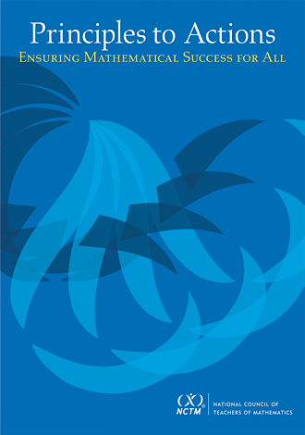

Practices to Actions:
Ensuring Mathematical Success for All
A Focus on
Effective Mathematics Teaching Practices
“Mr. Harris and the Band Concert Task”
Developed by: Dr. DeAnn Huinker,
University of Wisconsin–Milwaukee

Slide 2
Agenda
Examine the purpose and key messages of
NCTM’s Principles to Actions.
Read a case of a third-grade teacher using the Band Concert Task with his students.
Discuss the set of eight mathematics teaching practices and relate them to the case.
Reflect on next steps in strengthening these teaching practices in your own instruction.

Slide 3
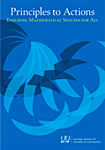
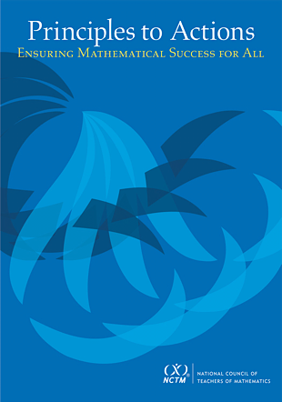
Principles to Actions

Slide 4
Principles to Actions:
Ensuring Mathematical Success for All
The primary purpose of Principles to Actions is to fill the gap between the adoption of rigorous standards and the enactment of practices, policies, programs, and actions required for successful implementation
of those standards.

Slide 5
Tools and Technology
Professionalism
Curriculum
Teaching and Learning
Assessment
Access and Equity
Guiding
Principles
for
School
Mathematics

Slide 6
Overarching Message
“Effective teaching is the non-negotiable core that ensures that all students learn mathematics at high levels.”
Principles to Actions (NCTM, 2014, p. 4)

Slide 7
Why Focus on Teaching?
Student learning of mathematics
“depends fundamentally on what happens inside the classroom as teachers and learners interact over the curriculum.”
(Ball & Forzani, 2011, p. 17)
Ball, D. L, & Forzani, F. M. (2011). Building a common core for learning to teach, and connecting professional learning to practice. American Educator, 35(2), 17-21.

Slide 8
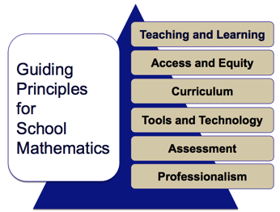
Teaching and Learning
Principle
“An excellent mathematics program requires effective teaching that engages students in meaningful learning through individual and collaborative experiences that promote their ability to make sense of mathematical ideas
and reason mathematically.”
Principles to Actions (NCTM, 2014, p. 7)

Slide 9
Effective
Mathematics
Teaching Practices

Slide 10
High-Leverage, Effective
Mathematics Teaching Practices
“Those practices at the heart of the work of teaching that are most likely to affect student learning.”
(Ball & Forzani, 2010, p. 45)
Ball, D. L, & Forzani, F. M. (2010). Teaching skillful teaching. Educational Leadership, 68(4), 40-45.

Slide 11
Effective Mathematics Teaching Practices
1. Establish mathematics goals to focus learning.
2. Implement tasks that promote reasoning and
problem solving.
3. Use and connect mathematical representations.
4. Facilitate meaningful mathematical discourse.
5. Pose purposeful questions.
6. Build procedural fluency from conceptual understanding.
7. Support productive struggle in learning mathematics.
8. Elicit and use evidence of student thinking.

Slide 12
Effective Mathematics Teaching Practices
1. Establish mathematics goals to focus learning.
2. Implement tasks that promote reasoning and
problem solving.
3. Use and connect mathematical representations.
4. Facilitate meaningful mathematical discourse.
5. Pose purposeful questions.
6. Build procedural fluency from conceptual understanding.
7. Support productive struggle in learning mathematics.
8. Elicit and use evidence of student thinking.

Slide 13
Task
The Band Concert

Slide 14
The Band Concert
Make a sketch or diagram of the situation that might be used by Grade 3 students.
Discuss potential approaches and struggles.
The third-grade class is responsible for setting
up the chairs for their spring band concert.
In preparation, they need to determine the
total number of chairs that will be needed
and ask the school’s engineer to retrieve that
many chairs from the central storage area.
The class needs to set up 7 rows of chairs with
20 chairs in each row, leaving space for a center
aisle.
How many chairs does the school’s engineer need
to retrieve from the central storage area?

Slide 15
Math Goals
What might be the math learning goals?
Tasks & Representations
What representations might students use in reasoning through and solving the problem?
Discourse & Questions
How might we question students and structure class discourse to advance student learning?
Fluency from Understanding
How might we develop student understanding to build toward aspects of procedural fluency?
Struggle & Evidence
How might we check in on student thinking and struggles and use it to inform instruction?

Slide 16
Case of Mr. Harris
and the
Band Concert Task

Slide 17

The Case of Mr. Harris and
the Band Concert Task
MR. HARRIS
Read the Case of Mr. Harris and study
the strategies used by his students.
Make note of what Mr. Harris did before or during instruction to support his students’ developing understanding of multiplication.
Talk with a neighbor about the “Teaching Practices” Mr. Harris is using and how they support students’ progress in their learning.

Slide 18
Relating the
Mathematics
Teaching Practices
to the Case

Slide 19
Math
Teaching
Practice
1
Establish mathematics
goals to focus learning.
Formulating clear, explicit learning goals sets the stage for everything else.
(Hiebert, Morris, Berk, & Janssen, 2007, p. 57)

Slide 20
Establish mathematics goals
to focus learning
Learning Goals should:
Clearly state what it is students are to learn and understand about mathematics as the result of instruction.
Be situated within learning progressions.
Frame the decisions that teachers make during a lesson.
Daro, Mosher, & Corcoran, 2011; Hattie, 2009;
Hiebert, Morris, Berk, & Jensen., 2007; Wiliam, 2011

Slide 21
Mr. Harris’s Math Goals
  Students will recognize the structure of multiplication as equal groups within and among different representations, focusing on identifying the number of equal groups and the size of each group within collections or arrays.
Student-friendly version ...
We are learning to represent and solve word problems and explain how different representations match the story situation and the math operations.

Slide 22

Alignment to the
Common Core State Standards
Standard 3.OA.3. Use multiplication and division within 100 to solve word problems in situations involving equal groups, arrays, and measurement quantities, e.g., by using drawings and equations with a symbol for the unknown number to represent the problem.
--------------------------------------------------------------
Standard 3.NBT. 3. Multiply one-digit whole numbers by multiples of 10 in the range 10–90 (e.g., 9 x 80,
5 x 60) using strategies based on place value and
properties of operations.

Slide 23
Questions
What were the math expectations
for student learning?
In what ways did these math goals focus the teacher’s interactions with students throughout the lesson?
Consider Case Lines 4-9, 21-24, 27-29.

Slide 24
Math
Teaching
Practice
2
Implement tasks that promote reasoning and problem solving.
Student learning is greatest in classrooms where the tasks consistently encourage high-level student thinking and reasoning and least in classrooms where the tasks are routinely procedural in nature.
(Boaler & Staples, 2008; Stein & Lane, 1996)

Slide 25
Implement tasks that promote
reasoning and problem solving
Mathematical tasks should:
Allow students to explore mathematical ideas or use procedures in ways that are connected to understanding concepts.
Build on students’ current understanding
and experiences.
Have multiple entry points.
Allow for varied solution strategies.
Boaler & Staples, 2008; Hiebert et al., 1997;
Stein, Smith, Henningsen, & Silver, 2009

Slide 26
Questions
In what ways did the implementation
of the task allow for multiple entry points and engage students in reasoning and problem solving?
Consider Case Lines 26-30 & 38-41.

Slide 27
Math
Teaching
Practice
3
Use and connect
mathematical representations.
Because of the abstract nature of mathematics, people have access to mathematical ideas only through the representations of those ideas.
(National Research Council, 2001, p. 94)

Slide 28
Use and connect
mathematical representations
Different Representations should:
Be introduced, discussed, and connected.
Be used to focus students’ attention on the structure of mathematical ideas by examining essential features.
Support students’ ability to justify and explain their reasoning.
Lesh, Post, & Behr, 1987; Marshall, Superfine, & Canty, 2010;
Tripathi, 2008; Webb, Boswinkel, & Dekker, 2008

Slide 29
Important Mathematical Connections between and within different types of representations
Visual
Physical
Symbolic
Contextual
Verbal
Principles to Actions (NCTM, 2014, p. 25)
(Adapted from Lesh, Post, & Behr, 1987)

Slide 30
What mathematical representations were students working with in the lesson?
How did Mr. Harris
support students in making connections between and within different types of representations?
Visual
Physical
Symbolic
Contextual
Verbal

Slide 31
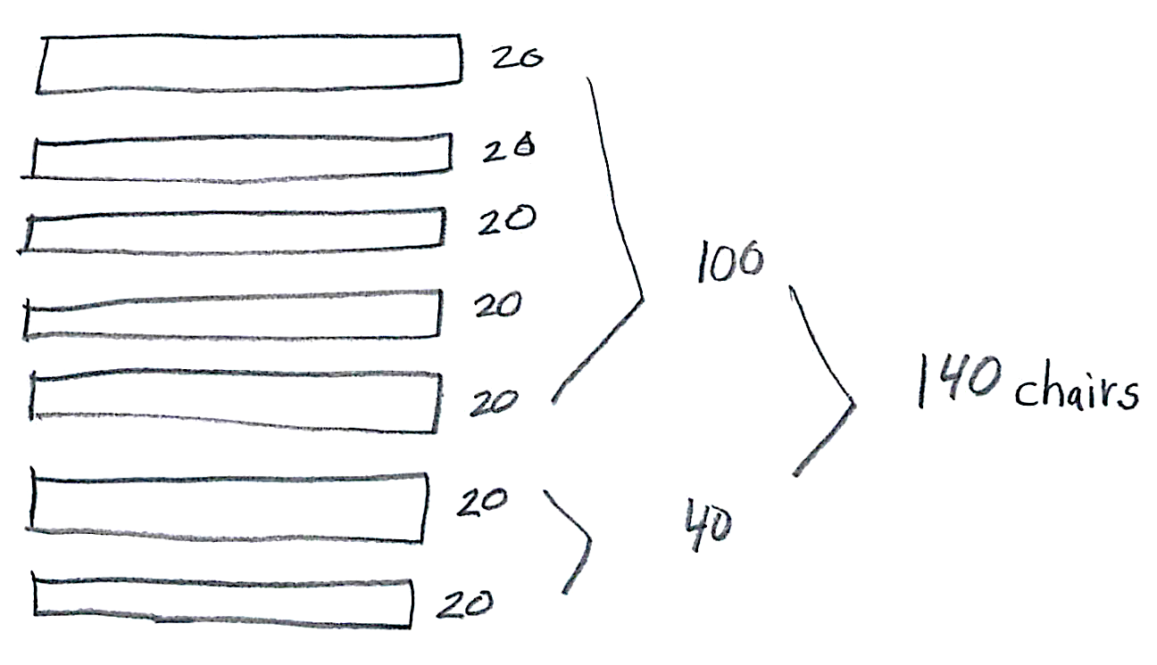
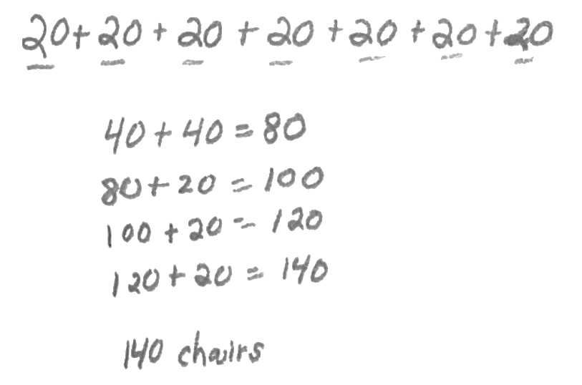
Consider Lines 43-48.
In what ways did comparing representations strengthen the understanding of these students?
Jasmine
Kenneth

Slide 32
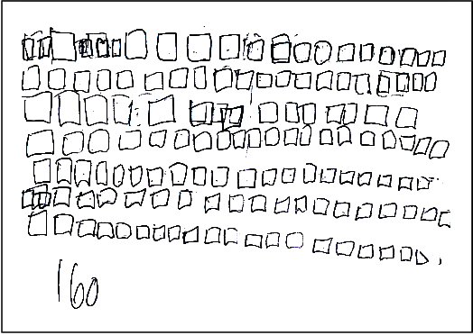
Consider Lines 48-49.
How did comparing representations benefit Molly?
Molly

Slide 33
Math
Teaching
Practice
4
Facilitate meaningful mathematical discourse.
Discussions that focus on cognitively challenging mathematical tasks, namely those that promote thinking, reasoning, and problem solving, are a primary mechanism for promoting conceptual understanding of mathematics.
(Hatano & Inagaki, 1991; Michaels, O’Connor, & Resnick, 2008)

Slide 34
Facilitate meaningful
mathematical discourse
Mathematical Discourse should:
Build on and honor students’ thinking.
Let students share ideas, clarify understandings, and develop convincing arguments.
Engage students in analyzing and comparing student approaches.
Advance the math learning of the whole class.
Carpenter, Franke, & Levi, 2003;
Fuson & Sherin, 2014; Smith & Stein, 2011

Slide 35
Questions
How did Mr. Harris structure the whole class discussion (lines 52-57) to advance student learning toward the intended math learning goals?

Slide 36
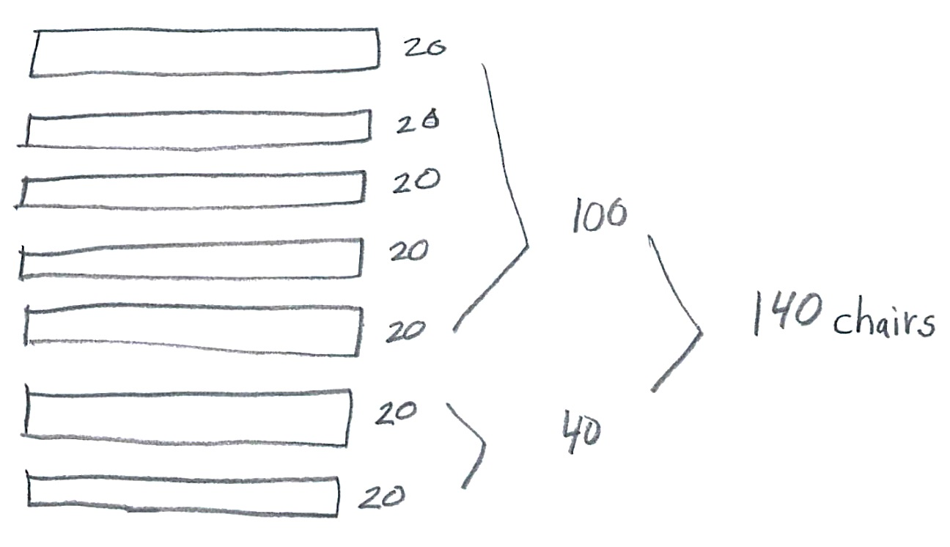
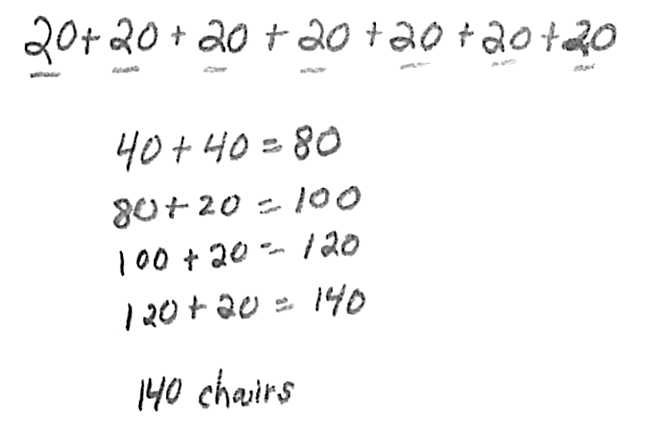
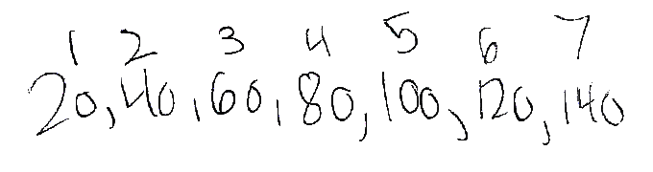
How does each representation match the story situation and the structure of multiplication?
Consider Lines 52-57.
Why did Mr. Harris select and sequence the work of these three students and how did that support student learning?
Jasmine
Kenneth
Teresa

Slide 37
Structuring Mathematical Discourse...
During the whole class discussion
of the task, Mr. Harris was strategic in:
Selecting specific student representations and strategies for discussion and analysis.
Sequencing the various student approaches for analysis and comparison.
Connecting student approaches to
key math ideas and relationships.

Slide 38
Anticipating
Monitoring
Selecting
Sequencing
Connecting
5 Practices for Orchestrating
Productive
Mathematics
Discussions
(Smith & Stein, 2011)

Slide 39
Math
Teaching
Practice
5
Pose purposeful questions.
Teachers’ questions are crucial in helping students
make connections and learn important mathematics and science concepts.
(Weiss & Pasley, 2004)

Slide 40
Pose purposeful questions
Effective Questions should:
Reveal students’ current understandings.
Encourage students to explain, elaborate, or clarify their thinking.
Make the targeted mathematical ideas more visible and accessible for student examination and discussion.
Boaler & Brodie, 2004; Chapin & O’Connor, 2007;
Herbel-Eisenmann & Breyfogle, 2005

Slide 41
Questions
In what ways did Mr. Harris’ questioning on lines 33-36 assess and advance student learning about important mathematical ideas and relationships?

Slide 42
Purposeful Questions
Lines 33-36
“How does your drawing show 7 rows?”
“How does your drawing show that there are
20 chairs in each row?
“How many twenties are you adding, and why?”
“Why are you adding all those twenties?
  Math Learning Goal
  Students will recognize the structure of multiplication as equal groups within and among different representations—identify the number of equal groups and the size of each group within collections or arrays.

Slide 43
Math
Teaching
Practice
6
Build procedural fluency from conceptual understanding.
A rush to fluency undermines students’
confidence and interest in mathematics and is considered a cause of mathematics anxiety.
(Ashcraft 2002; Ramirez Gunderson, Levine, & Beilock, 2013)

Slide 44
Build procedural fluency
from conceptual understanding
Procedural Fluency should:
Build on a foundation of conceptual understanding.
Over time (months, years), result in known facts and generalized methods for solving problems.
Enable students to flexibly choose among methods to solve contextual and mathematical problems.
Baroody, 2006; Fuson & Beckmann, 2012/2013;
Fuson, Kalchman, & Bransford, 2005; Russell, 2006

Slide 45
Questions
In what ways did this lesson develop a foundation of conceptual understanding for building toward procedural fluency in multiplying with multiples of ten?

Slide 46
Questions
What foundational understandings were students developing at each of these points in the lesson that are critical for moving toward procedural fluency?
Lines 59-69: Discussion of skip counting.
Lines 70-76: Wrote the multiplication equation.
Lines 78-81: Asked students to compare
Tyrell and Ananda’s work.

Slide 47
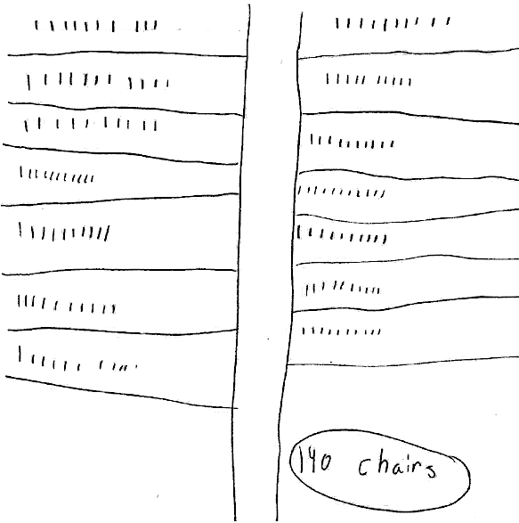
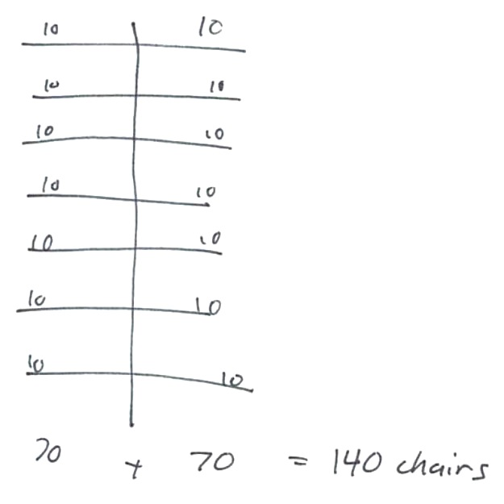
Discuss ways to use this student work to develop the understanding that 14 tens = 140 and to meaningfully to build toward fluency in working with multiples of ten.
Tyrell
Ananda

Slide 48
Discuss ways to use this student work to develop informal ideas of the distributive property—how numbers can be decomposed, combined meaningfully in parts, and then recomposed to find the total.
Tyrell
Ananda

Slide 49
“Fluency builds from initial exploration and discussion of number concepts to using informal reasoning strategies based on meanings and properties of the operations to the eventual use of general methods as tools in solving problems.”
Principles to Actions (NCTM, 2014, p. 42)

Slide 50
Math
Teaching
Practice
7
Support productive struggle
in learning mathematics.
The struggle we have in mind comes from solving problems that are within reach and grappling with key mathematical ideas that are comprehendible but not yet well formed.
(Hiebert, Carpenter, Fennema, Fuson,
Human, Murray, Olivier, & Wearne, 1996)

Slide 51
Support productive struggle
in learning mathematics
Productive Struggle should:
Be considered essential to learning mathematics with understanding.
Develop students’ capacity to persevere in the face of challenge.
Help students realize that they are capable of doing well in mathematics with effort.
Black, Trzesniewski, & Dweck, 2007; Dweck, 2008;
Hiebert & Grouws, 2007; Kapur, 2010; Warshauer, 2011

Slide 52
Questions
How did Mr. Harris support productive struggle among his students, individually and collectively, as they grappled with important mathematical ideas and relationships?
At which points in the lesson might Mr. Harris have consciously restrained himself from “taking over” the thinking of his students?

Slide 53
Math
Teaching
Practice
8
Elicit and use evidence
of student thinking.
Teachers using assessment for learning continually look for ways in which they can generate evidence of student learning, and they use this evidence to adapt their instruction to better meet their students’ learning needs.
(Leahy, Lyon, Thompson, & Wiliam, 2005, p. 23)

Slide 54
Elicit and use evidence
of student thinking
Evidence should:
Provide a window into students’ thinking.
Help the teacher determine the extent to which students are reaching the math learning goals.
Be used to make instructional decisions during the lesson and to prepare for subsequent lessons.
Chamberlin, 2005; Jacobs, Lamb, & Philipp, 2010;
Sleep & Boerst, 2010; van Es, 2010’ Wiliam, 2007

Slide 55
Questions
Identify specific places during the lesson (cite line numbers) in which Mr. Harris elicited evidence of student learning.
Discuss how he used or might use that evidence to adjust his instruction to support and extend student learning.

Slide 56
Examples of
Eliciting and Using Evidence
Throughout the lesson, Mr. Harris was eliciting and using evidence of student thinking.
Lines 33-36: Purposeful questioning as students worked individually.
Lines 43-51: Observations of student pairs discussing and comparing their representations.
Lines 59-74: Whole class discussion.
Lines 78-80: Asked students to respond in writing.

Slide 57
Reflections
and Next Steps

Slide 58
NCTM’s Core Set of
Effective Mathematics Teaching Practices
“Although the important work of teaching is not limited to the eight Mathematics Teaching Practices, this core set of research-informed practices is offered as a framework for strengthening the teaching and learning of mathematics.”
Principles to Actions (NCTM, 2014, p. 57)

Slide 59
Effective Mathematics Teaching Practices
1. Establish mathematics goals to focus learning.
2. Implement tasks that promote reasoning and
problem solving.
3. Use and connect mathematical representations.
4. Facilitate meaningful mathematical discourse.
5. Pose purposeful questions.
6. Build procedural fluency from conceptual understanding.
7. Support productive struggle in learning mathematics.
8. Elicit and use evidence of student thinking.

Slide 60
Development
As you reflect on this framework for the teaching and learning of mathematics, identify 1-2 mathematics teaching practices that want to begin strengthening in your own instruction.
Working with a partner, develop a list of actions to begin the next steps of your journey toward ensuring mathematical success for all of your students.

Slide 61
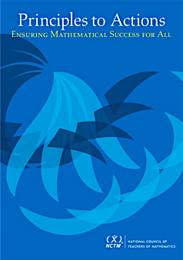
Thank You!
Dr. DeAnn Huinker
University of Wisconsin–Milwaukee
huinker@uwm.edu
02.17.15

Slide 62
