Slide 1

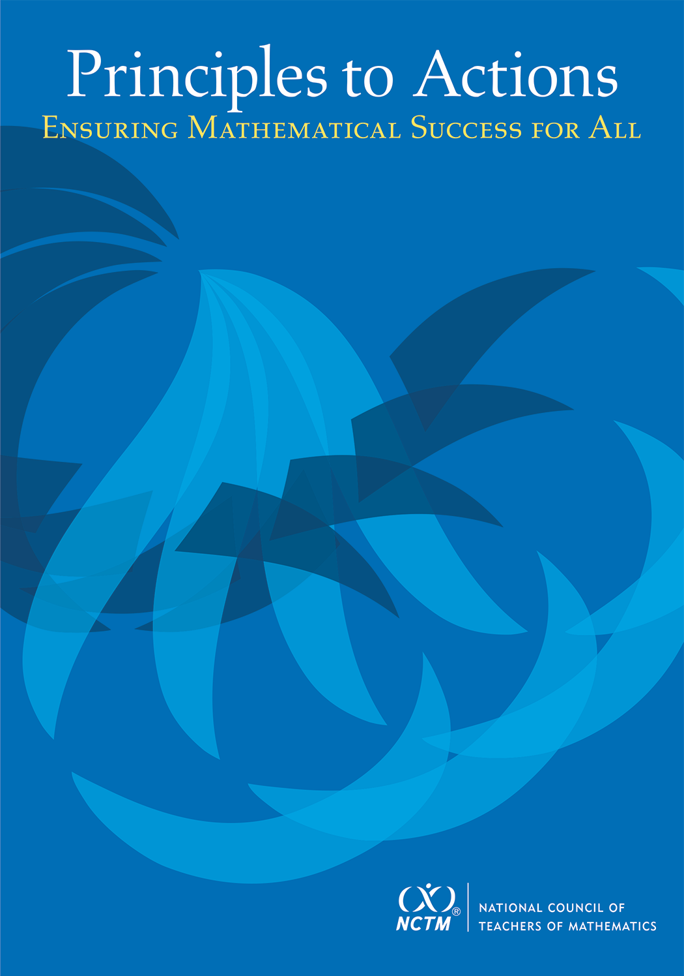
Warm-up Problem
A candy jar contains 5 Jolly Ranchers (squares) and 13 Jawbreakers (circles). Suppose you had a new candy jar with the same ratio of Jolly Ranchers to Jawbreakers, but it contained 100 Jolly Ranchers. How many Jawbreakers would you have? Explain how you know.
Please try to do this problem in as many ways as you can, both correct and incorrect.
If done, share your work with a neighbor or look at the solutions on the back of the handout.

Slide 2
Principles to Actions:
Ensuring Mathematical Success
for All
A Focus on Effective Teaching Practices

Slide 3
Agenda
Discuss a new publication from NCTM that is intended to support implementation of CCSSM and other rigorous standards
Read and analyze a short case of a teacher (Mr. Donnelly) who is attempting to support his students’ learning
Discuss a set of eight teaching practices and relate them to the case
Discuss how to get started in making these practices central to your instruction

Slide 4
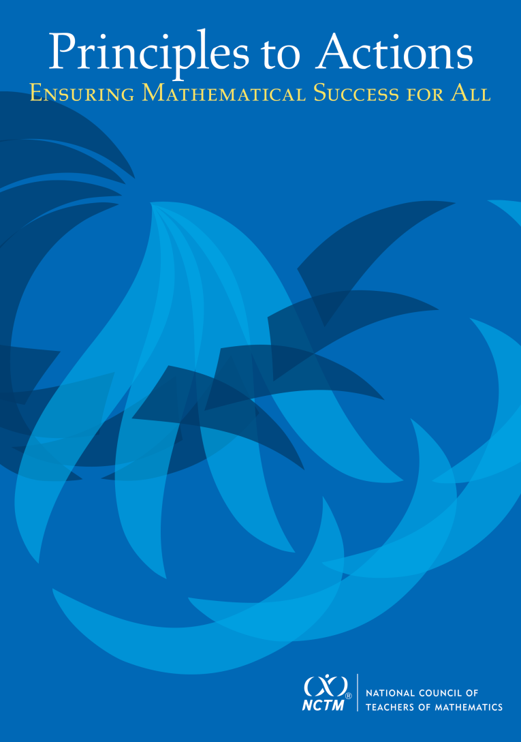
Principles to Actions:
Ensuring Mathematical Success for All
The primary purpose of PtA is to fill the gap between the adoption of rigorous standards and the enactment of practices, policies, programs, and actions required for successful implementation of those standards.

Slide 5
Guiding Principles
for School Mathematics
Teaching and Learning
Effective teaching is the non-negotiable core that ensures that all students learn mathematics at high levels.

Slide 6
Guiding Principles
for School Mathematics
Teaching and Learning
Access and Equity
Curriculum
Tools and Technology
Assessment
Professionalism
Essential Elements
of Effective Math
Programs

Slide 7
Guiding Principles
for School Mathematics
Teaching and Learning
Access and Equity
Curriculum
Tools and Technology
Assessment
Professionalism

Slide 8
Principle on Teaching and Learning
An excellent mathematics program requires effective teaching that engages students in meaningful learning through individual and collaborative experiences that promote their ability to make sense of mathematical ideas and reason mathematically.

Slide 9
We Must Focus on Instruction
Student learning of mathematics “depends fundamentally on what happens inside the classroom as teachers and learners interact over the curriculum.”
(Ball & Forzani, 2011, p. 17)
“Teaching has 6 to 10 times as much impact on achievement as all other factors combined ... Just three years of effective teaching accounts on average for an improvement of 35 to 50 percentile points.”
(Schmoker, 2006, p. 9)

Slide 10
The Case of Mr. Donnelly
Read the Case of Mr. Donnelly and study the strategies used by his students.
Make note of what Mr. Donnelly did before or during instruction to support his students’ learning and understanding of proportional relationships.
Talk with a neighbor about the actions and interactions that you identified as supporting student learning.

Slide 11
Effective
Mathematics Teaching Practices
Establish mathematics goals to focus learning.
Implement tasks that promote reasoning and problem solving.
Use and connect mathematical representations.
Facilitate meaningful mathematical discourse.
Pose purposeful questions.
Build procedural fluency from conceptual understanding.
Support productive struggle in learning mathematics.
Elicit and use evidence of student thinking.

Slide 12
Establish Mathematics Goals
To Focus Learning
Learning Goals should:
Clearly state what it is students are to learn and understand about mathematics as the result of instruction;
Be situated within learning progressions; and
Frame the decisions that teachers make during a lesson.
Formulating clear, explicit learning goals sets the stage for everything else.
(Hiebert, Morris, Berk, & Janssen, 2007, p.57)

Slide 13
Goals to Focus Learning
Mr. Donnelly’s goal for students’ learning:
  Students will recognize that quantities that are in a proportional (multiplicative) relationship grow at a constant rate.
How does his goal align with this teaching practice?

Slide 14
Implement Tasks that Promote
Reasoning and Problem Solving
Mathematical tasks should:
Provide opportunities for students to engage in exploration or encourage students to use procedures in ways that are connected to concepts and understanding;
Build on students’ current understanding; and
Have multiple entry points.
There is no decision that teachers make that has a greater impact on students’ opportunities to learn and on their perceptions about what mathematics is than the selection or creation of the tasks with which the teacher engages students in studying mathematics.
(Lappan & Briars, 1995)

Slide 15
Tasks that Promote
Reasoning and Problem Solving
How is Mr. Donnelly’s task (Candy Jar) similar to or different from the Missing Value problem?
Which one is more likely to promote problem solving?

Slide 16






Tasks that Promote
Reasoning and Problem Solving
How is Mr. Donnelly’s task (Candy Jar) similar to or different from the Missing Value problem?
Which one is more likely to promote problem solving?
Finding the Missing Value
Find the value of the unknown in each of the proportions shown below.

Slide 17
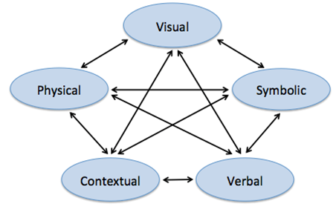
Use and Connect
Mathematical Representations
Different Representations should:
Be introduced, discussed, and connected;
Focus students’ attention on the structure or essential features of mathematical ideas; and
Support students’ ability to justify and explain their reasoning.
Strengthening the ability to move between and among these representations improves the growth of children’s concepts.
(Lesh, Post, Behr, 1987)

Slide 18
Connecting Representations
What different representations were used and connected in Mr. Donnelly’s class?
How might his students benefit from making these connections?

Slide 19
Facilitate
Meaningful Mathematical Discourse
Mathematical Discourse should:
Build on and honor students’ thinking;
Provide students with the opportunity to share ideas, clarify understandings, and develop convincing arguments; and
Advance the mathematical learning of the whole class.
Discussions that focus on cognitively challenging mathematical tasks, namely those that promote thinking, reasoning, and problem solving, are a primary mechanism for promoting conceptual understanding of mathematics (Hatano & Inagaki, 1991; Michaels, O’Connor, & Resnick, 2008).
(Smith, Hughes, Engle & Stein, 2009, p. 549)

Slide 20
Meaningful Discourse
What did Mr. Donnelly do (before or during the discussion) that may have positioned him to engage his students in a productive discussion?

Slide 21
Pose Purposeful Questions
Effective Questions should:
Reveal students’ current understandings;
Encourage students to explain, elaborate, or clarify their thinking; and
Make the mathematics more visible and accessible for student examination and discussion.
Teachers’ questions are crucial in helping students make connections and learn important mathematics and science concepts. Teachers need to know how students typically think about particular concepts, how to determine what a particular student or group of students thinks about those ideas, and how to help students deepen their understanding.
(Weiss & Pasley, 2004)

Slide 22
Purposeful Questions
What did you notice about the questions that Mr. Donnelly asked on lines 38-71?
What purpose did the questions serve?

Slide 23
Build Procedural Fluency from Conceptual Understanding
Procedural Fluency should:
Build on a foundation of conceptual understanding;
Result in generalized methods for solving problems; and
Enable students to flexibly choose among methods to solve contextual and mathematical problems.
Students must be able to do much more than carry out mathematical procedures. They must know which procedure is appropriate and most productive in a given situation, what a procedure accomplishes, and what kind of results to expect. Mechanical execution of procedures without understanding their mathematical basis often leads to bizarre results.
(Martin, 2009, p. 165)

Slide 24

Procedural Fluency
What might we expect the students in Mr. Donnelly’s class to be able to do when presented with a missing value problem, after they have had the opportunity to develop a set of strategies through solving a variety of contextual problems like the Candy Jar Task?

Slide 25
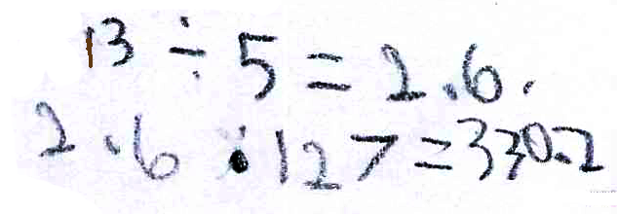
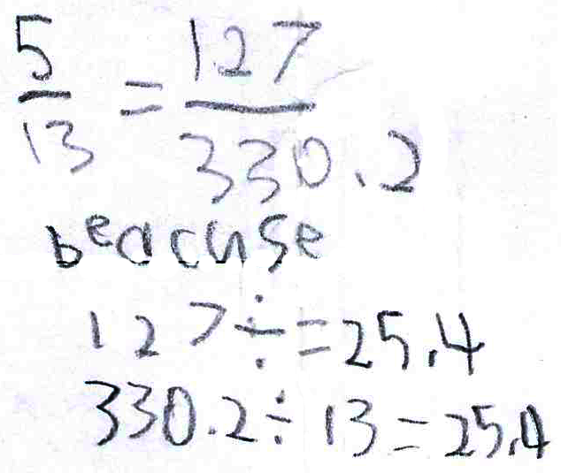
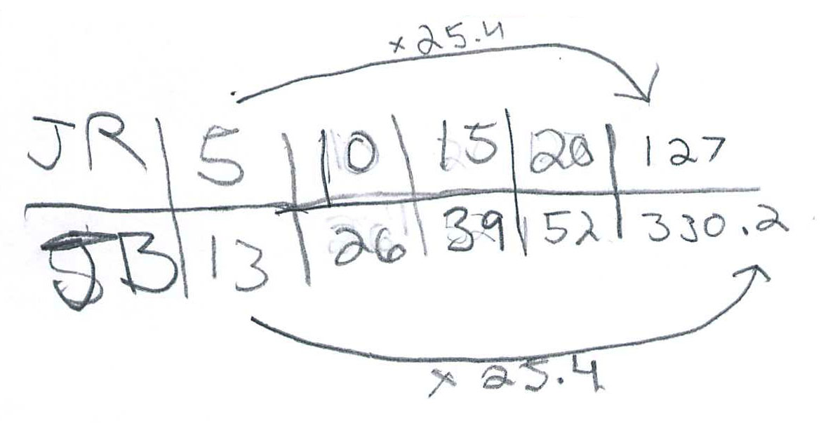
Procedural Fluency

Slide 26
Procedural Fluency
Unit Rate
Scale Factor
Scaling Up

Slide 27
Support Productive Struggle
in Learning Mathematics
Productive Struggle should:
Be considered essential to learning mathematics with understanding;
Develop students’ capacity to persevere in the face of challenge; and
Help students realize that they are capable of doing well in mathematics with effort.
The struggle we have in mind comes from solving problems that are within reach and grappling with key mathematical ideas that are comprehendible but not yet well formed (Hiebert et al., 1996). By struggling with important mathematics we mean the opposite of simply being presented information to be memorized or being asked only to practice what has been demonstrated.
(Hiebert & Grouws, 2007, pp. 387-388)

Slide 28
Productive Struggle
How did Mr. Donnelly support students when they struggled?
What would have happened if he had been more directive with his students?

Slide 29
Another Candy Jar Lesson
As students in Ms. Pascal’s sixth grade classroom began working with their partners on the first candy jar problem, she walked around the room stopping at different groups to listen in on their conversations. It soon became evident to Ms. Pascal that students were struggling to get started. She called the class together and reminded them of the table they had created the previous day in which they had generated ratios equivalent to 5 JRs to 13 JBs. She suggested that they might want to consider extending the table in order to find out how many JBs there would be when you had 100 JRs. Students returned to their partner work with renewed energy. As Ms. Pascal continued to monitor their progress, she noted that students were easily able to extend the table and arrive at the correct answer.

Slide 30
Elicit and Use Evidence
of Student Thinking
Evidence should:
Provide a window into students’ thinking;
Help the teacher determine the extent to which students are reaching the math learning goals; and
Be used to make instructional decisions during the lesson and to prepare for subsequent lessons.
Formative assessment is an essentially interactive process, in which the teacher can find out whether what has been taught has been learned, and if not, to do something about it. Day-to-day formative assessment is one of the most powerful ways of improving learning in the mathematics classroom.
(Wiliam, 2007, pp. 1054; 1091)

Slide 31
Evidence of Student Thinking
To what extent did Mr. Donnelly elicit students’ thinking?
To what extent did (or could) Mr. Donnelly use the evidence to inform his instruction?

Slide 32
“If your students are going home at the end of the day less tired than you are, the division of labor in your classroom requires some attention.”
Wiliam, D. (2011)

Slide 33
Getting Started
Learn more about the effective teaching practices from reading the book, exploring other resources, and talking with your colleagues and administrators.
Engage in observations and analysis of teaching (live or in narrative or video form) and discuss the extent to which the eight practices appear to have been utilized by the teacher and what impact they had on teaching and learning.
Co-plan lessons with colleagues using the eight effective teaching practices as a framework. Invite the math coach (if you have one) to participate.
Observe and debrief lessons with particular attention to what practices were used in the lesson and how the practices did or did not support students’ learning.

Slide 34
Thank You!
pegs@pitt.edu

Slide 35
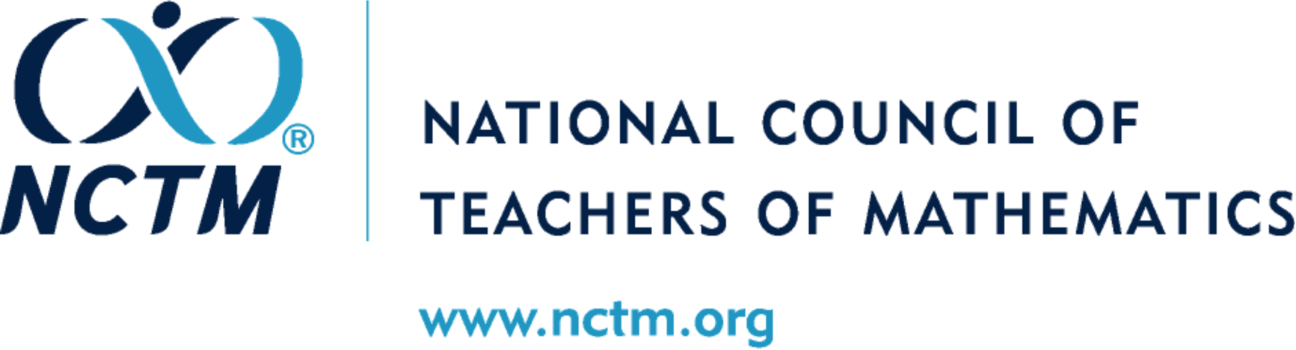

Slide 36
Candy Jar Task
Common Core State Standards 7.RP:
2. Recognize and represent proportional relationships between quantities.
Decide whether two quantities are in a proportional relationship, e.g., by testing for equivalent ratios in a table or graphing on a coordinate plane and observing whether the graph is a straight line through the origin.
Identify the constant of proportionality (unit rate) in tables, graphs, equations, diagrams, and verbal descriptions of proportional relationships.
Represent proportional relationships by equations. For example, if total cost t is proportional to the number n of items purchased at a constant price p, the relationship between the total cost and the number of items can be expressed as t = pn.
Explain what a point (x, y) on the graph of a proportional relationship means in terms of the situation, with special attention to the points (0, 0) and (1, r) where r is the unit rate.

Slide 37
Candy Jar Task
Common Core State Standards 7.RP:
2. Recognize and represent proportional relationships between quantities.
Decide whether two quantities are in a proportional relationship, e.g., by testing for equivalent ratios in a table or graphing on a coordinate plane and observing whether the graph is a straight line through the origin.
Identify the constant of proportionality (unit rate) in tables, graphs, equations, diagrams, and verbal descriptions of proportional relationships.
Represent proportional relationships by equations. For example, if total cost t is proportional to the number n of items purchased at a constant price p, the relationship between the total cost and the number of items can be expressed as t = pn.
Explain what a point (x, y) on the graph of a proportional relationship means in terms of the situation, with special attention to the points (0, 0) and (1, r) where r is the unit rate.

Slide 39
Alternate template
Principles to Actions:
Ensuring Mathematical Success for All
  Describes the supportive conditions, structures, and policies required to give all students the power of mathematics
  Focuses on teaching and learning
  Engages students in mathematical thinking
  How to ensure that mathematics achievement is maximized for every student
  Not specific to any standards; it’s universal

