Slide 1
Using Identity and Agency to Frame Access and Equity

Slide 2
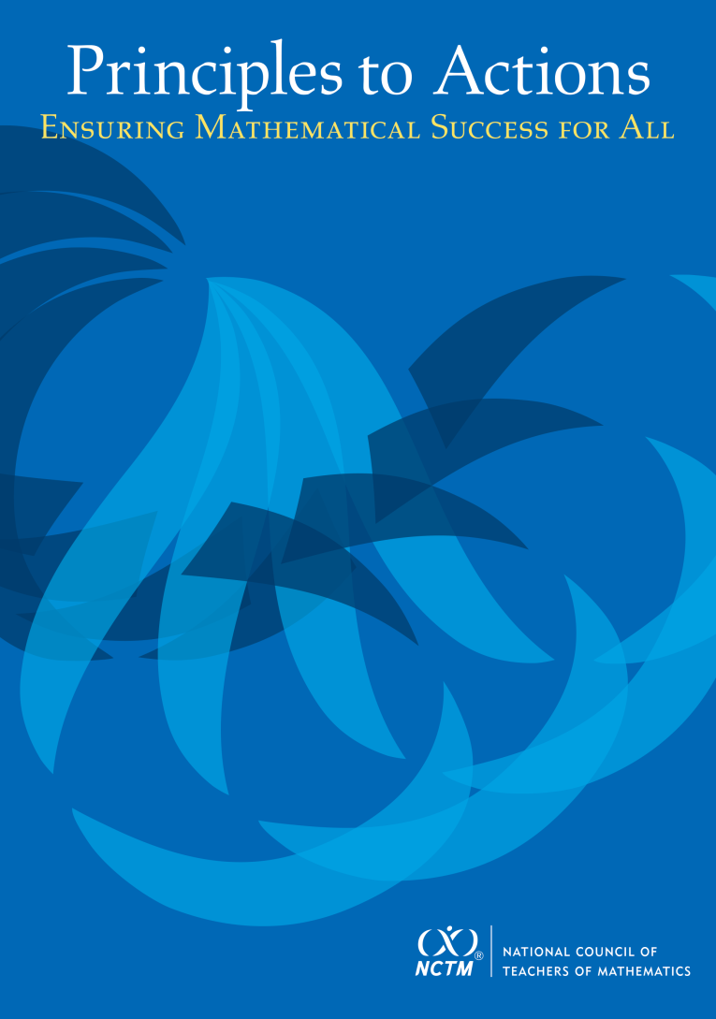
Principles to Actions: Ensuring Mathematical Success for All

Slide 3
Principles to Actions: Ensuring Mathematical Success for All
Essential Elements of School Mathematics Program
Access and Equity
Curriculum
Tools and Technology
Assessment
Professionalism

Slide 4
Access and Equity Principle
An excellent mathematics program requires that all students have access to a high-quality mathematics curriculum, effective teaching and learning, high expectations, and the support and resources needed to maximize their learning potential.

Slide 5
Calvin’s Story
Talker-Listener Exchange:
One person is the talker and the others are listeners.
The talker will talk continuously and the listeners listen but may respond non-verbally with gestures (but not words).

Slide 6
Interwoven Identities
Am I not being recommended for placement in pre-algebra course because I am no longer a good student who is good at mathematics?
Am I not being recommended because I am perceived as a behavioral problem?
Am I not being recommended because middle school is different from elementary?
Am I not being recommended for placement in pre-algebra course because I am a Black boy?

Slide 7
Interwoven Identities
“I want to go to the Air Force Academy and become a pilot. You have to be good at math to get into the Academy.” Andre
Identities are not mutually exclusive
Identities serve as motivation to persevere
Notes:
This short example along with other interviews and observations reveal that Andre negotiates several interwoven identities (e.g., academic identity, mathematics identity, racial identity and future occupational identity) that are important to him and that these identities serve as motivations for him to persevere and do well with mathematics.

Slide 8
Interwoven
Mathematics
Identity
Identity Affirming
Agency
Notes:
What are the interwoven identities expressed by your students?
In what ways, if any, do you affirm the identities of your students?
What teaching practice do I use to support and affirm students’ mathematics identity development?
What structures are in place for students to demonstrate a high sense of agency?
How do students demonstrate high and low sense of agency in my mathematics classroom?

Slide 9
Mathematics Identity
beliefs about one’s self as a mathematics learner,
one’s perceptions of how others perceive them as a mathematics learner,
beliefs about the nature of mathematics,
engagement in mathematics, and
perception of self as a potential participant in mathematics.
(Solomon, 2009)
Think about you as student in your classroom.

Slide 10
Identity & Motivation
Understanding the strengths and motivations that serve to develop students’ identities should be embedded in the daily work of teachers.
Mathematics teaching involves not only helping students develop mathematical skills but also empowering students to seeing themselves as being doers of mathematics.
Notes:
This understanding of students’ identities gives teachers insights to how and why some students might make positive connections with mathematics and others do not.
Teachers can use this understanding to provide opportunities for students to use mathematics to examine personal, communal, and social contexts.
In providing these opportunities, students may find the motivation and connections with mathematics to see the relevance for their future thus developing a mathematics identity.

Slide 11
Supporting Teaching
Mathematics teaching should leverage students’ culture, contexts, and identities to support and enhance mathematics learning (NCTM, 2014).
Notes:
Mathematics teaching should leverage students’ culture, contexts, and identities to support and enhance mathematics learning (NCTM, 2014).
By understanding the significance and relevance of the alternative identities and contexts, mathematics teachers can draw on community resources to understand how they can use contexts, culture, conditions, and language to support mathematics teaching and learning.

Slide 12
Agency
Agency is our identity in action and the presentation of our identity to the world (Aguirre, Ingram & Martin, 2013).
Social and behavioral expectations are associated with agency.

Slide 13
Agency
If one identifies himself as being smart and good at mathematics, then he presents himself and adopt behaviors and actions of smartness and being good at mathematics.
Once this presentation of smartness and being good at mathematics is affirmed, then students see themselves as active participants and doers of mathematics (Berry, 2014).

Slide 14
Identity Affirming
Identity-affirming behaviors influence the ways in which students participate in mathematics and how they see themselves as doers of mathematics.
We see identity-affirming criteria emerging as learners are labeled as “smart,” “gifted,” “proficient,” “at-risk,” or “on grade-level”

Slide 15
Identity Affirming
We affirm mathematics identities by providing opportunities for students to make sense of and persevere in challenging mathematics.
Facilitate meaningful mathematical discourse
Support productive struggle in learning mathematics
Elicit and use evidence of student thinking
This kind of teaching cultivates and affirms mathematical participation and behaviors
(NCTM, 2014)
Notes:
A student who identifies themselves as being at good mathematics might exhibit behaviors and participate to maintain their status as person who is “smart” or good at mathematics.
Teachers affirm mathematics identities by providing opportunities for students make sense of and preserve in challenging mathematics.
Students should be engage with mathematics that requires active participation, asking questions, problem posing, and reasoning.
This kind of teaching values all students’ thinking and uses pedagogical practices, such as differentiated tasks, mixed ability groupings, and publicly praising contributions and perseverance, to cultivate and affirm mathematical participation and behaviors (NCTM 2014).

Slide 16
High Sense of Agency
Students with a high sense of agency make decisions about their participation in mathematics.
“I gotta excel in everything I do. Be the best that I can be…being the best means doing your work, asking questions, and being involved in class.” (Bilal)
“Good math students are focused, do their work, and want to make A’s all the time…I am a good math student.” (Andre)
Notes:
A high sense of agency is having a high degree of self-exploration that is associated with a high degree of self-direction in determining one’s life course (Côté & Schwartz, 2002).
Students with a high sense of agency make decisions about their participation in mathematics.
Bilal show a high sense of agency by stating, “I gotta excel in everything I do. Be the best that I can be…being the best means doing your work, asking questions, and being involved in class.”
Andre’s sums up his sense of agency by stating, “Good math students are focused, do their work, and want to make A’s all the time…I am a good math student.”
In these statements we see a high sense of agency that is resistant to the negative identities imposed on them because these boys perceive themselves as having a sense of control over their academic success because they knew that, in order to maintain their good standing in mathematics, they needed to be participatory in the mathematics classroom.

Slide 17
Shaping Identity & Agency
“I don’t know how she does it, but sometimes she knows what we are going to say before we say anything…she knows us so well that she gets us out of trouble before we get in trouble…In math, she know the right thing to say to help us with our work.” (Jabari)

Slide 18
Identity Affirming
Students need opportunities to learn using their strengths and opportunities to learn by compensating for their the challenges (Sternberg, 2007)
We must provide opportunities that play to the strengths and challenges of students.

Slide 19
Caroline & Craig
Talker-Listener Exchange:
In the Caroline and Craig vignette, we see experiences that potential shape Caroline and Craig’s identities and dispositions towards mathematics.

Slide 20
Mathematics Identity
beliefs about one’s self as a mathematics learner,
one’s perceptions of how others perceive them as a mathematics learner,
beliefs about the nature of mathematics,
engagement in mathematics, and
perception of self as a potential participant in mathematics.
(Solomon, 2009)

Slide 21
Beliefs about Access and Equity
Unproductive Beliefs | Productive Beliefs
Students possess different innate levels of ability in mathematics, and these cannot be changed by instruction. | Mathematics ability is a function of opportunity, experience, and effort—not of innate intelligence.
Students living in poverty lack the cognitive, emotional, and behavioral characteristics to participate and achieve in mathematics. | Effective teaching practices have the potential to open up greater opportunities for higher-order thinking and for raising the mathematics achievement of all students

Slide 22
Overcoming Obstacles
Educators need to identify, acknowledge, and discuss the mindsets and beliefs that they have about students’ abilities.
Fixed Mindset: Believe that you are either smart or you are not
Growth Mindset: Intelligence and “smartness” can be learned and that the brain can grow from exercise
(Dweck, 2006)
Notes:
a ‘growth mindset’ then they believe that intelligence and ‘smartness’ can be learned and that the brain can grow from exercise. The implications of this mindset are profound -- students with a growth mindset work and learn more effectively, displaying a desire for challenge and resilience in the face of failure
‘fixed mindset’ believe that you are either smart or you are not. When students with a fixed mindset fail or make a mistake they believe that they are just not smart and give up. Such students frequently avoid challenge, preferring instead to complete easier work on which they know they will succeed.
Identity affirming

Slide 23
Overcoming Obstacles
Access to rigorous, high-quality mathematics, taught by teachers who not only understand mathematics but also understand and appreciate learners’ social and cultural contexts in meaningful ways.
Classroom environments that foster a sense of community that allows students to express their mathematical ideas.
Notes:
Context

Slide 24
Actions: Leaders and Policymakers
Allocate resources to ensure that all students are provided with an appropriate amount of instructional time to maximize their learning potential.
Ensure that teachers at all levels are emphasizing the mathematical practices as a key element of their instruction for all students.

Slide 25
Actions: Leaders and Policymakers
Eliminate the tracking of low-achieving students and instead structure interventions that provide high-quality instruction and other classroom support, such as math coaches and specialists.
Provide support structures, co-curricular activities, and resources to increase the numbers of students from all racial, ethnic, gender, and socioeconomic groups who attain the highest levels of mathematics achievement.

Slide 26
Actions: Principals, Coaches, & Specialist
Consider teacher assignment practices to ensure that struggling students have access to effective mathematics teaching…
Maintain a school-wide culture with high expectations and a growth mindset.
Develop and implement high-quality interventions.
Ensure that curricular and extracurricular resources are available to support and challenge all students.

Slide 27
Actions: Teachers
Develop socially, emotionally, and academically safe environments for mathematics teaching and learning…
Understand and use the social contexts, cultural backgrounds, and identities of students as resources to foster access, motivate students to learn more mathematics, and engage student interest.
Model high expectations for each student’s success in problem solving, reasoning, and understanding.
Promote the development of a growth mindset among students.

