Slide 1
Where in the World?
Slide 1A

Slide 2
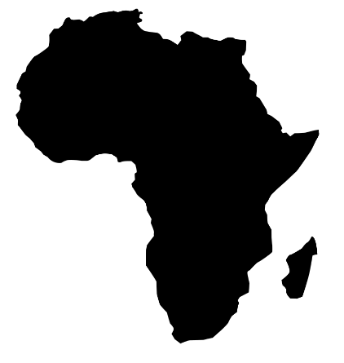
What do you Know?
Slide 1

Slide 3
Once upon a time, there were people who didn't know just how amazing they were. They had special talents, but they hadn't discovered them yet. As they went about their days, a magical spark waited inside each one, ready to shine brightly.
A people losing sight of origins are dead.
A people deaf to purpose are lost.
Under fertile rain, in scorching sunshine there is no difference:
their bodies are mere corpses, awaiting final burial.
Ayi Kwei Armah (1973, p. xiv)
Slide 2

Slide 4
The Richest People to Ever Live????
Story of Mansa Musa
This Photo by Unknown Author is licensed under CC BY-NC
Slide 3
Notes:
Additional Video: https://www.google.com/search?client=safari&sca_esv=34b23c430a4204cf&sca_upv=1&rls=en&sxsrf=AM9HkKmvNtiedHHdfxl4R0gM6shvZUN9Xw:1702609638939&q=mansa+musa+video+for+kids&tbm=vid&source=lnms&sa=X&ved=2ahUKEwiV--CVu5CDAxVVTTABHTkeAKUQ0pQJegQICRAB&biw=1440&bih=820&dpr=2#fpstate=ive&vld=cid:852d98e4,vid:KD1yraxgikk,st:0

Slide 5
Timbuktu was a very important place in Africa a long time ago. It was a home to a big university with 25,000 students! People there learned about Islam, which is a religion, and many other things like law, medicine, and math. The university had a huge library with lots of books – about 400,000 to 700,000!
- Revised using Text Leveler by Magic School
Original Text: Timbuktu was a center of Islamic scholarship under several African empires, home to a 25,000-student university …. for the spread of Islam throughout Africa from the 12th to 16th centuries…. The great teachings of Islam, law, medicine, philosophy, astronomy, chemistry, physics, history, and Mathematics with the largest library in the world of about 400,000 – 700,000 manuscripts.
Slide 4

Slide 6
Slide 5

Slide 7
Lagos, Nigeria
Slide 6

Slide 8
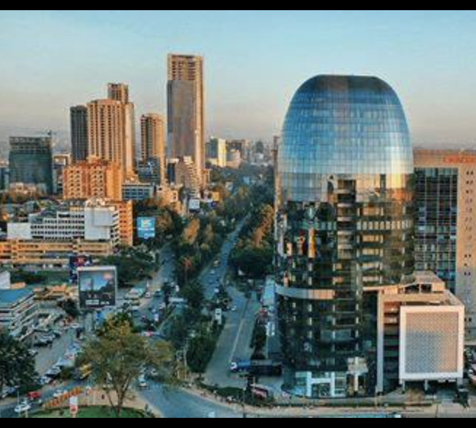
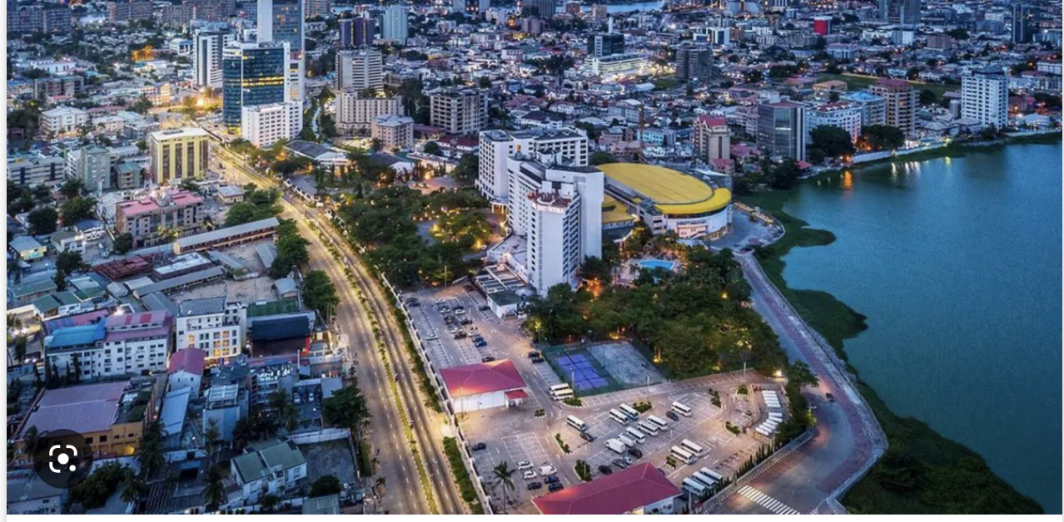
Nairobi, Kenya
Slide 7

Slide 9
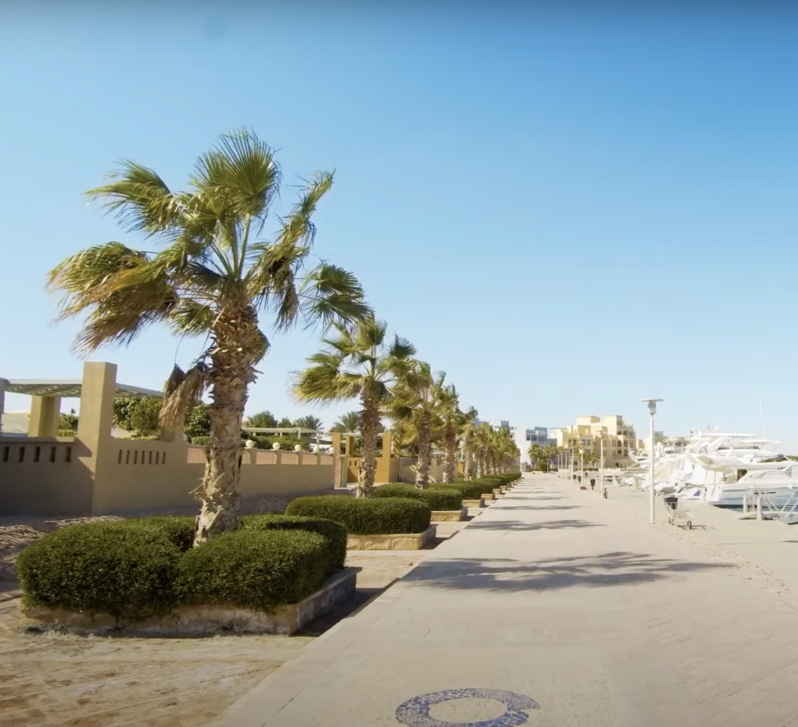
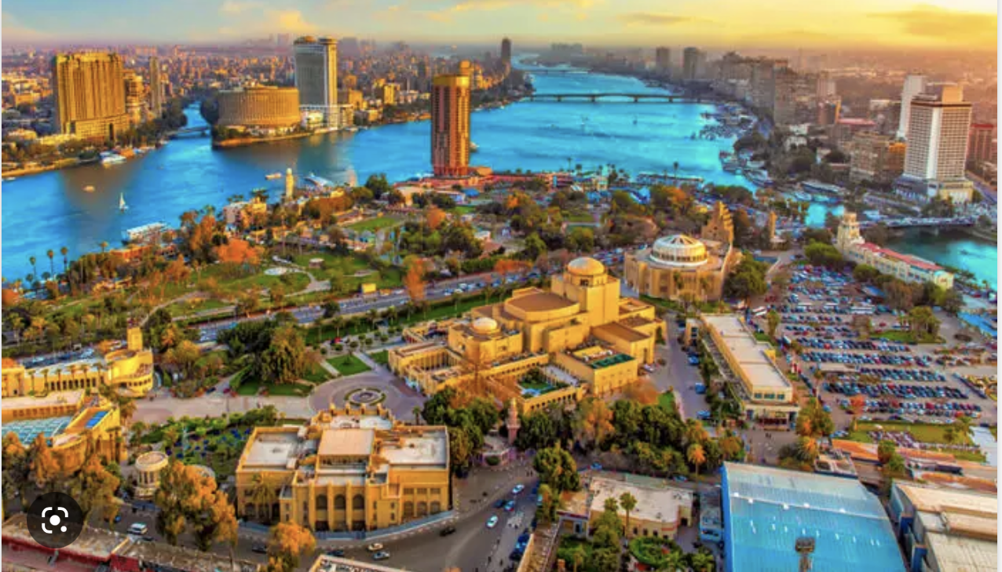
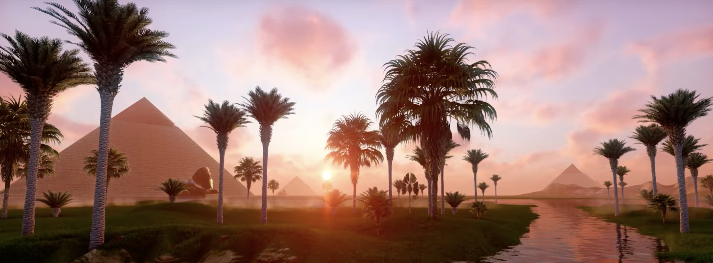
Cairo, Egypt
Slide 8

Slide 10
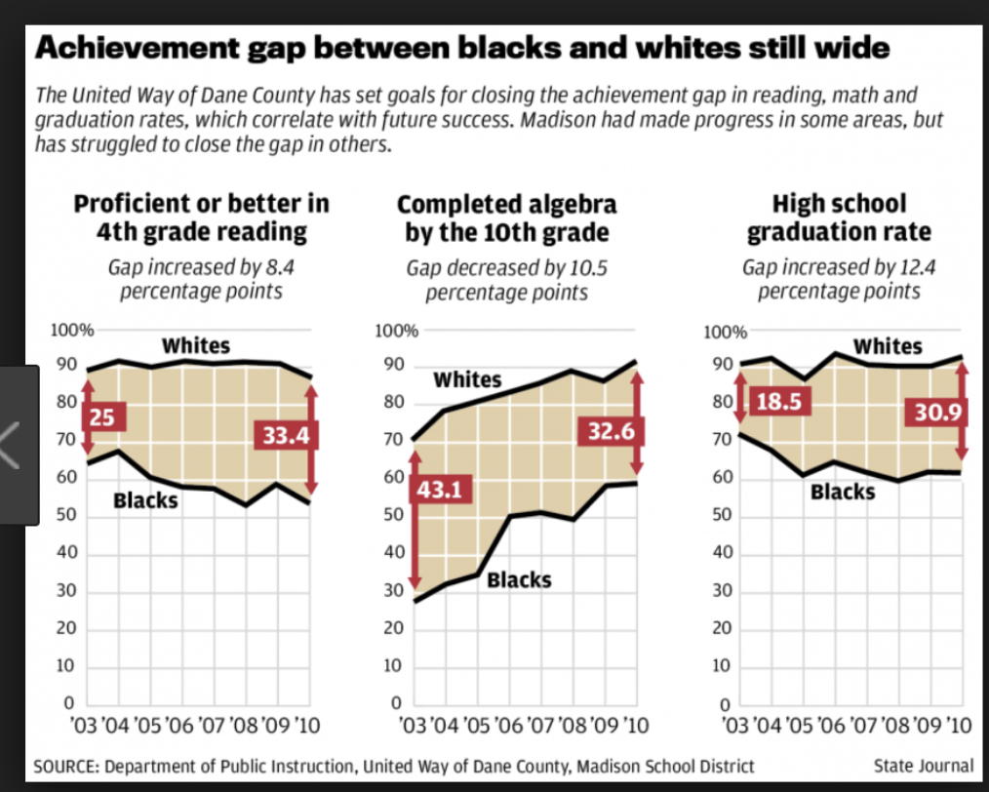
Slide 9
Notes:
https://www.nationsreportcard.gov/dashboards/achievement_gaps.aspx#

Slide 11
1956, French researcher Marcelle Gerber – Kenya & Uganda
Mid 60’s, US researcher William Frankenburg, MD
2006 , Iowa dissertation - Phyllis Rippeyoung
de 6
Slide 10
Black babies have slightly higher cognitive-skill scores and considerably higher motor-skill scores than their European peer group. | Black babies have better thinking and movement skills compared to White babies. - Revised using Text Leveler by Magic School

Slide 12
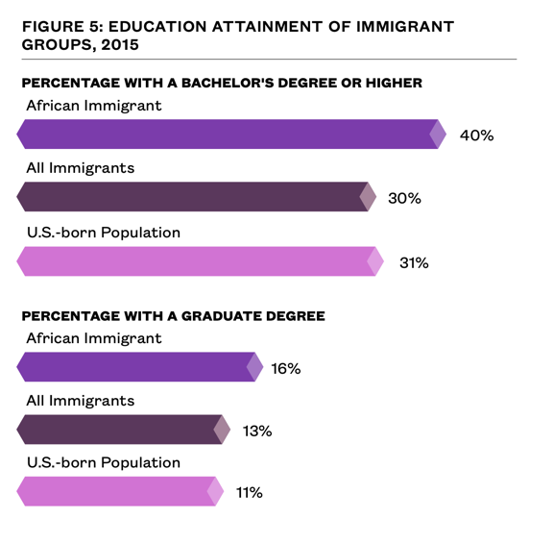
Slide 11

