Slide 1
Group 10
Hundred Grid

Slide 2
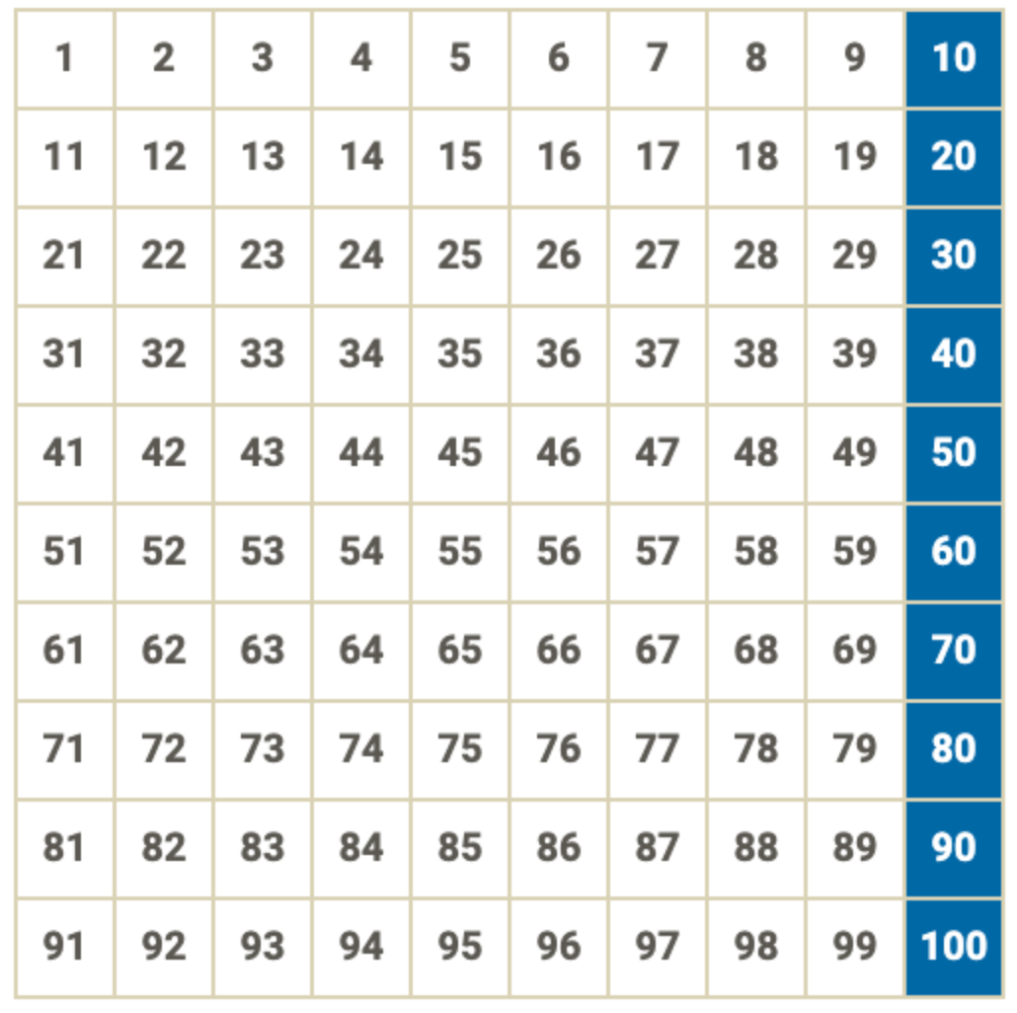
What patterns do you see?
ADD HERE

