Slide 1
Group 2
Hundred Grid

Slide 2
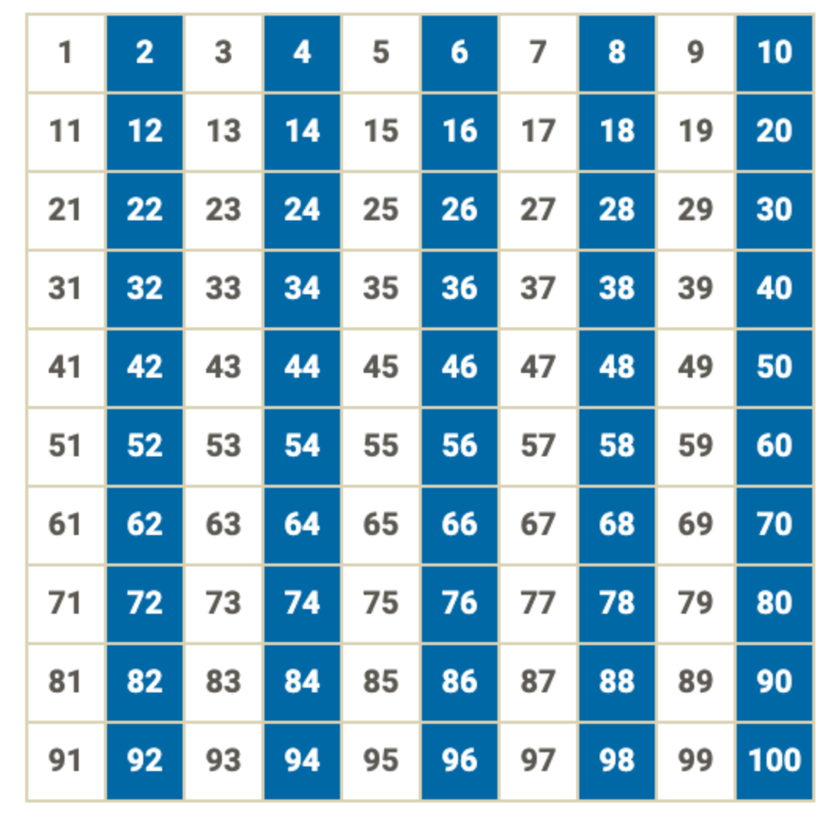
What patterns do you see?
ADD HERE

