Slide 1
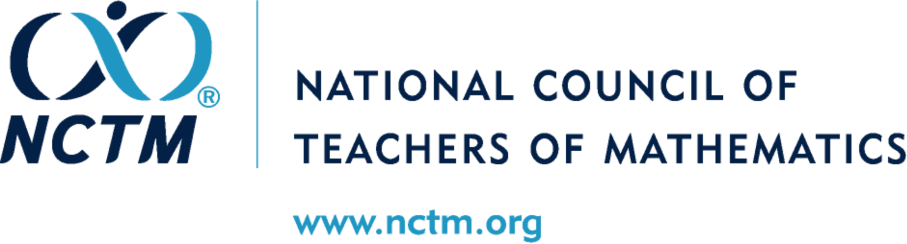

Slide 2

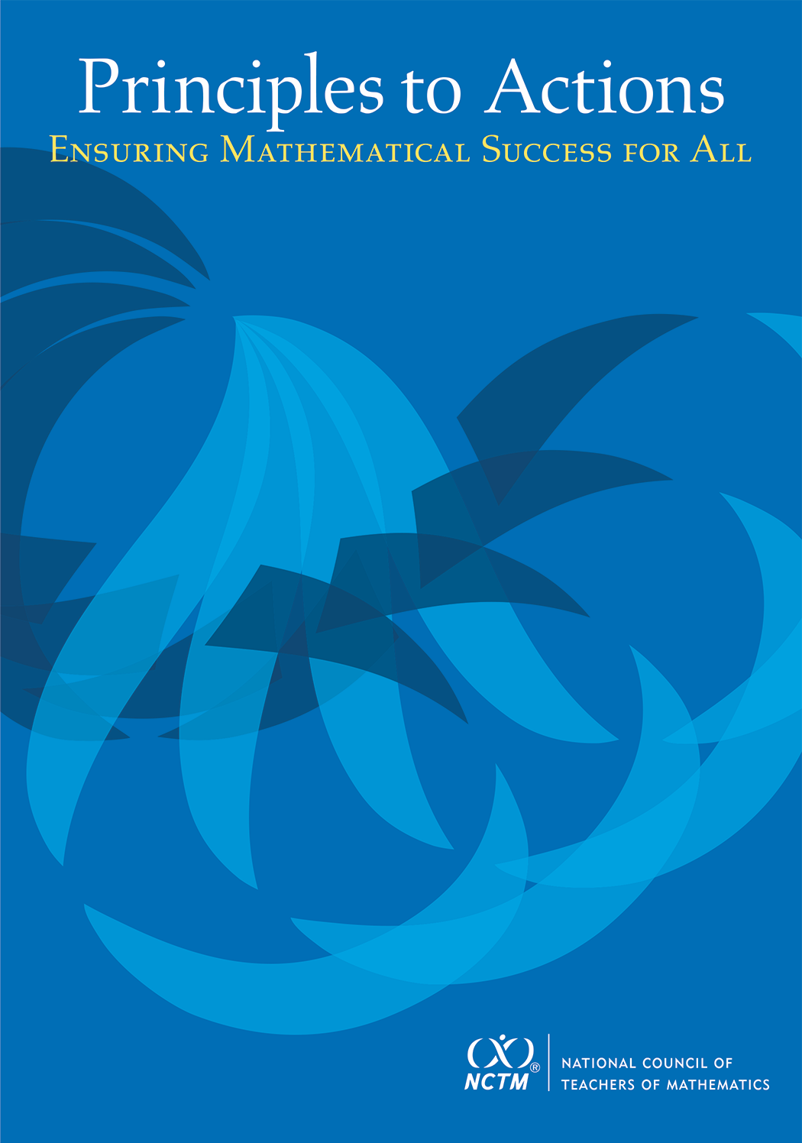
Principles to Actions:
Ensuring Mathematical Success
for All

Slide 3

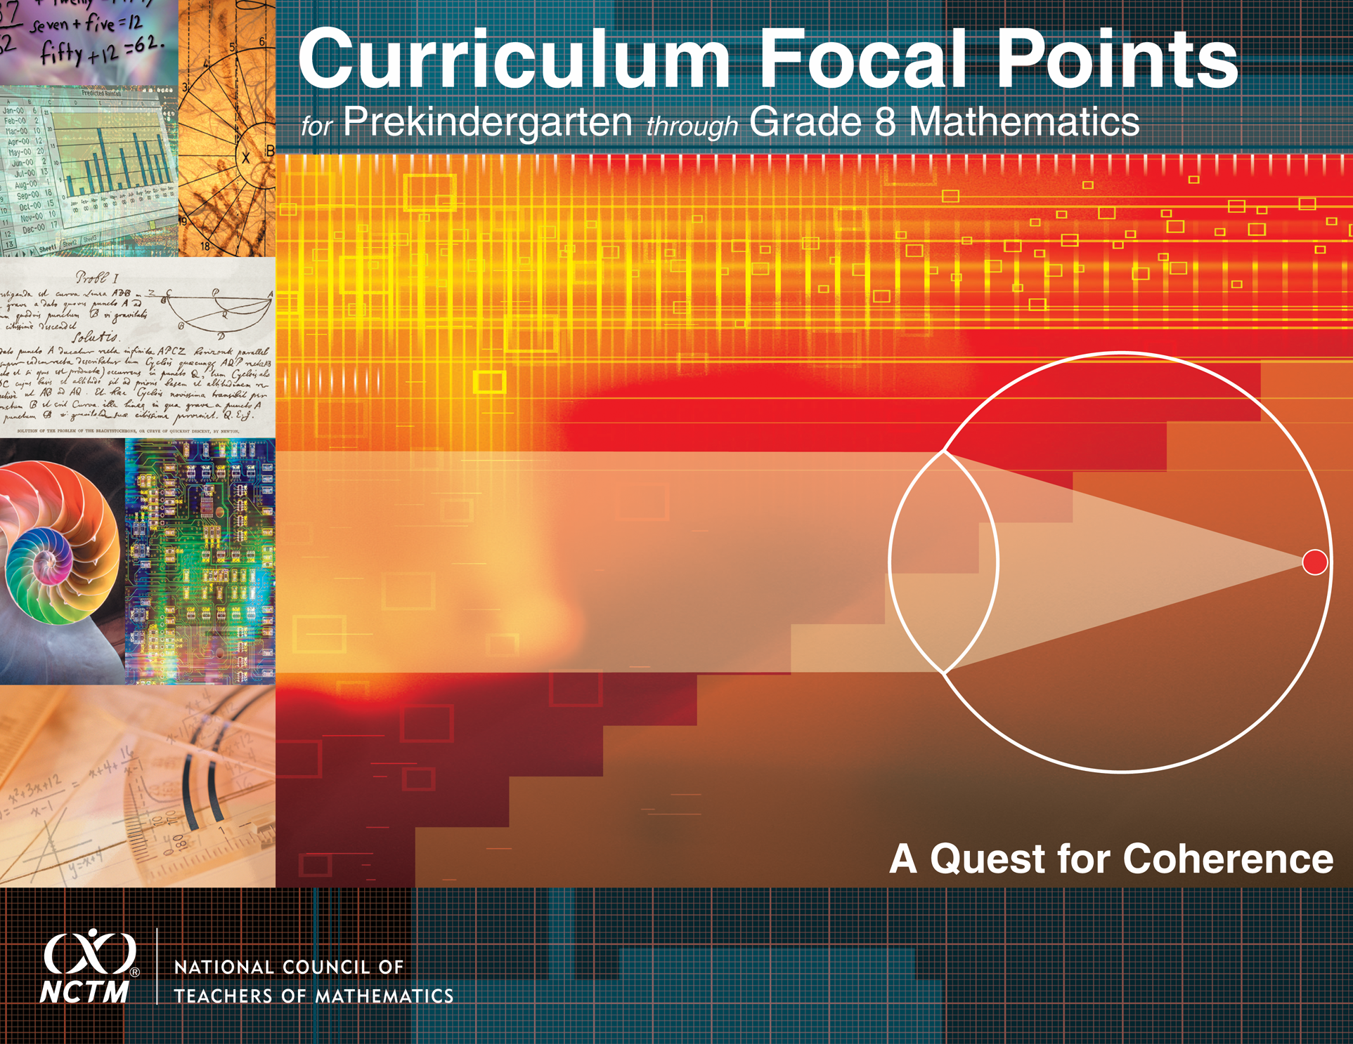
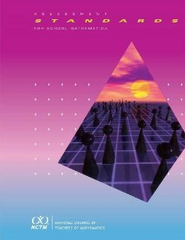
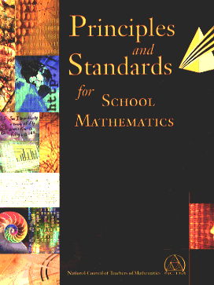
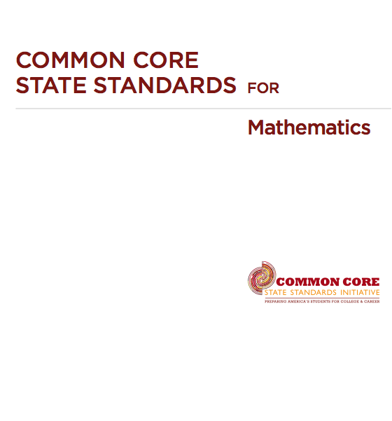
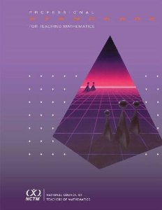
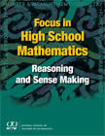
A 25-year History of Standards-Based Mathematics Education Reform
1989 Curriculum and Evaluation Standards for School Mathematics
2006 Curriculum Focal Points
2010 Focus in High School Mathematics
2000 Principles and Standards for School Mathematics
2010 Common Core State Standards for Mathematics

Slide 4
Standards Have Contributed
to Higher Achievement
The percent of 4th graders scoring proficient or above on NAEP rose from 13% in 1990 to 42% in 2013.
The percent of 8th graders scoring proficient or above on NAEP rose from 15% in 1990 to 36% in 2013.
Between 1990 and 2012, the mean SAT-Math score increased from 501 to 514 and the mean ACT-Math score increased from 19.9 to 21.0.

Slide 5
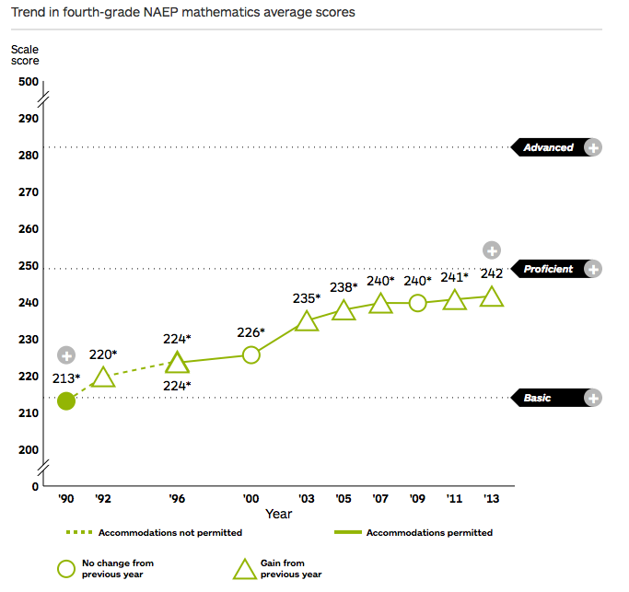
Trend in Grade 4 NAEP Mathematics Scores
National Center for Education Statistics. (2013). The Nation’s Report Card: A First Look: 2013 Mathematics and Reading (NCES 2014-451). Institute of Education Sciences, U.S. Department of Education, Washington, DC.

Slide 6
Although We Have Made Progress, Challenges Remain
The average mathematics NAEP score for 17-year-olds has been essentially flat since 1973.
Among 34 countries participating in the 2012 Programme for International Student Assessment (PISA) of 15-year-olds, the U.S. ranked 26th in mathematics.
While many countries have increased their mean scores on the PISA assessments between 2003 and 2012, the U.S. mean score declined.
Significant learning differentials remain.

Slide 7
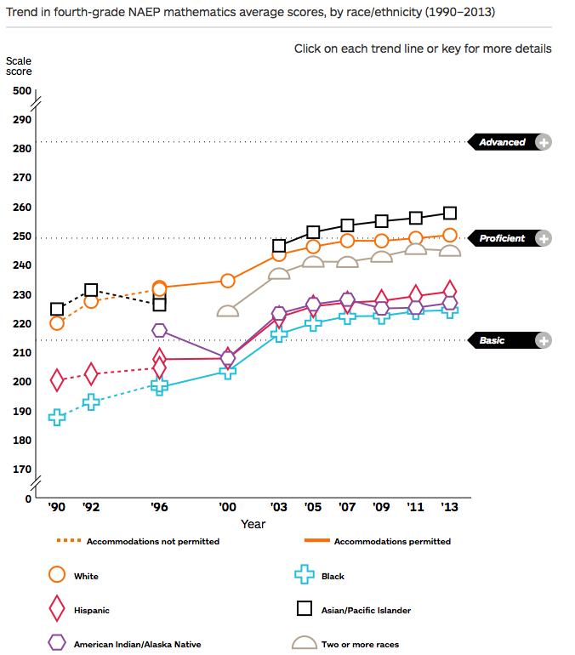
Trend in Grade 4 Mathematics By Race/Ethnicity
National Center for Education Statistics. (2013). The Nation’s Report Card: A First Look: 2013 Mathematics and Reading (NCES 2014-451). Institute of Education Sciences, U.S. Department of Education, Washington, DC.

Slide 8
High-Quality Standards are Necessary for Effective Teaching and Learning,
But Insufficient
The Common Core does not describe or prescribe the essential conditions required to make sure mathematics works for all students.

Slide 9
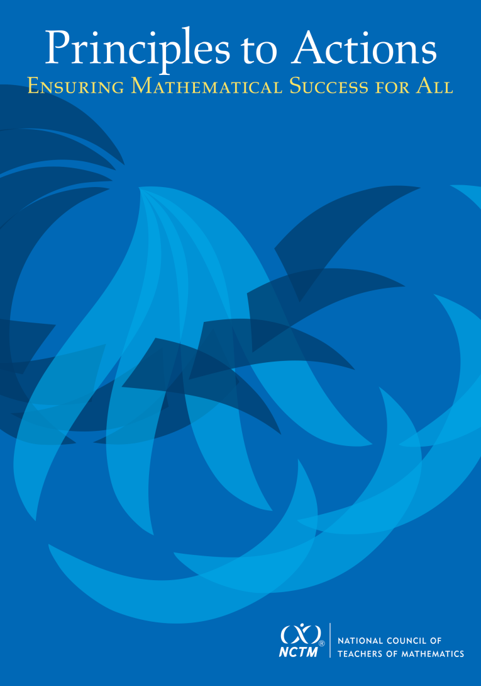
Principles to Actions:
Ensuring Mathematical Success for All
The primary purpose of Principles to Actions is to fill the gap between the adoption of rigorous standards and the enactment of practices, policies, programs, and actions required for successful implementation of those standards.
NCTM. (2014). Principles to Actions: Ensuring Mathematical Success for All. Reston, VA: NCTM.

Slide 10
Principles to Actions:
Ensuring Mathematical Success for All
The overarching message is that effective teaching is the non-negotiable core necessary to ensure that all students learn mathematics. The six guiding principles constitute the foundation of PtA that describe high-quality mathematics education.
NCTM. (2014). Principles to Actions: Ensuring Mathematical Success for All. Reston, VA: NCTM.

Slide 11
Guiding Principles
for School Mathematics
Teaching and Learning
Access and Equity
Curriculum
Tools and Technology
Assessment
Professionalism
Essential Elements
of Effective Mathematics
Programs

Slide 12
For Each Principle
Productive and Unproductive Beliefs are Listed
Obstacles to Implementing the Principle are Outlined
Overcoming the Obstacles
Taking Action
  Leaders and Policymakers
  Principles, Coaches, Specialists, Other School Leaders
  Teachers

Slide 13
Teaching and Learning Principle
Teaching and Learning
An excellent mathematics program requires effective teaching that engages students in meaningful learning through individual and collaborative experiences that promote their ability to make sense of mathematical ideas and reason mathematically.

Slide 14
Obstacles to Implementing
High-Leverage Instructional Practices
Dominant cultural beliefs about the teaching and learning of mathematics continue to be obstacles to consistent implementation of effective teaching and learning in mathematics classrooms.

Slide 15
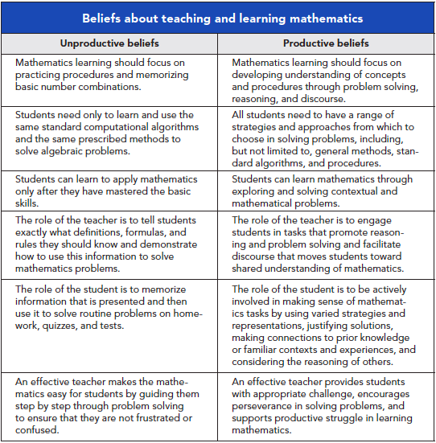
Beliefs About Teaching and Learning Mathematics

Slide 16
Eight High-Leverage
Instructional Practices
Establish mathematics goals to focus learning
Implement tasks that promote reasoning and problem solving
Use and connect mathematical representations
Facilitate meaningful mathematical discourse
Pose purposeful questions
Build procedural fluency from conceptual understanding
Support productive struggle in learning mathematics
Elicit and use evidence of student thinking

Slide 17
Eight Research-Informed
Instructional Practices
Establish mathematics goals to focus learning.
Effective teaching of mathematics establishes clear goals for the mathematics that students are learning, situates goals within learning progressions, and uses goals to guide instructional decisions.

Slide 18
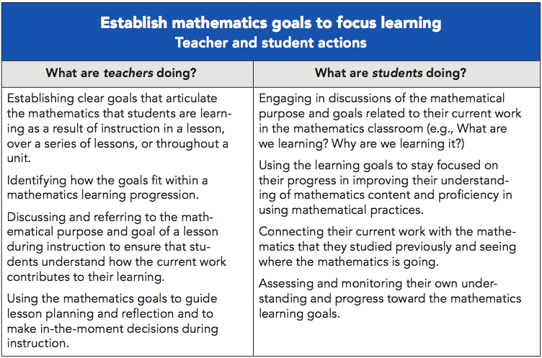

Slide 19
Eight High-Leverage
Instructional Practices
Implement tasks that promote reasoning and problem solving.
Effective teaching of mathematics engages students in solving and discussing tasks that promote mathematical reasoning and problem solving and that allow for multiple entry points and varied solution strategies.

Slide 20
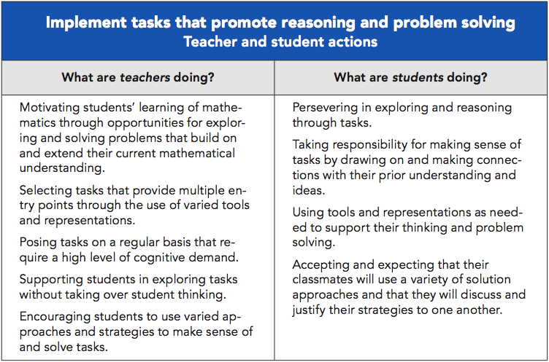

Slide 21
Eight Research-Informed
Instructional Practices
Use and connect mathematical representations.
Effective teaching of mathematics engages students in making connections among mathematical representations to deepen understanding of mathematics concepts and procedures and as tools for problem solving.

Slide 22
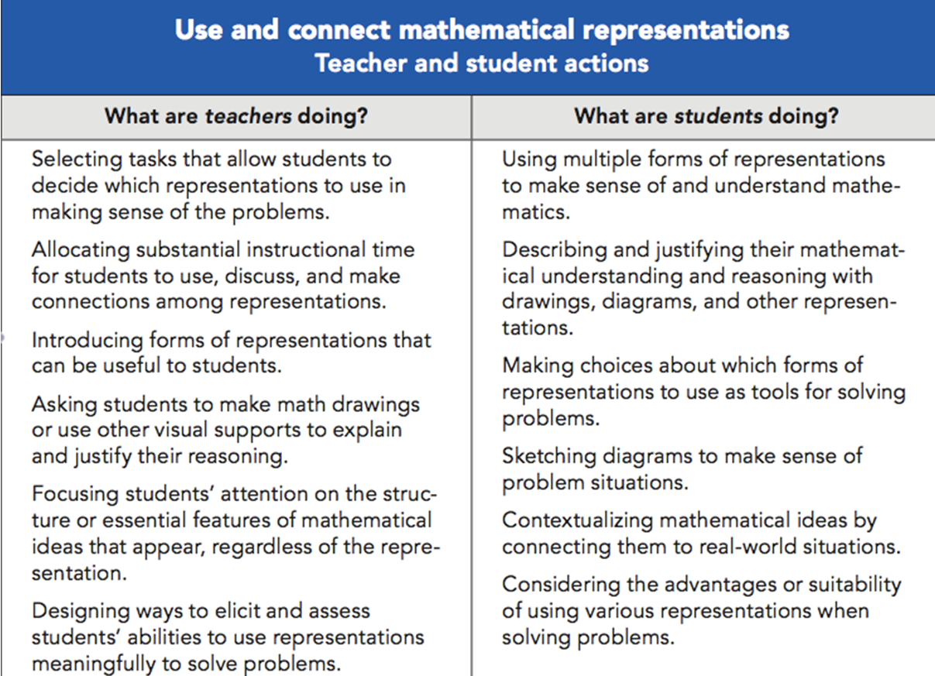

Slide 23
Eight High-Leverage
Instructional Practices
Facilitate meaningful mathematical discourse.
Effective teaching of mathematics facilitates discourse among students in order to build shared understanding of mathematical ideas by analyzing and comparing student approaches and arguments.

Slide 24
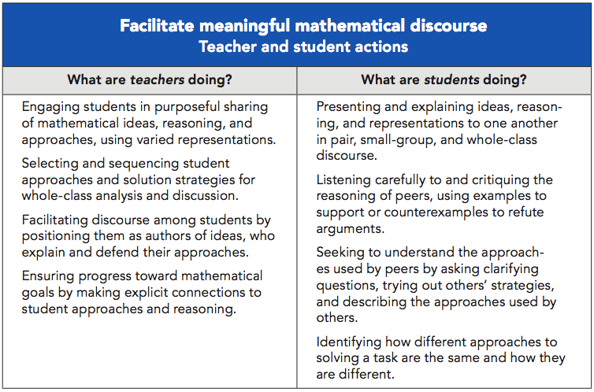

Slide 25
Eight Research-Informed
Instructional Practices
Pose purposeful questions.
Effective teaching of mathematics uses purposeful questions to assess and advance student reasoning and sense making about important mathematical ideas and relationships.

Slide 26
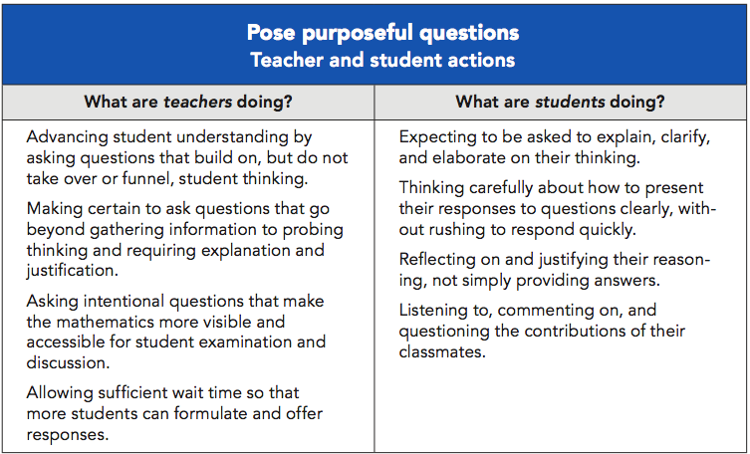

Slide 27
Eight Research-Informed
Instructional Practices
Build procedural fluency from conceptual understanding.
Effective teaching of mathematics builds fluency with procedures on a foundation of conceptual understanding so that students, over time, become skillful in using procedures flexibly as they solve contextual and mathematical problems.

Slide 28
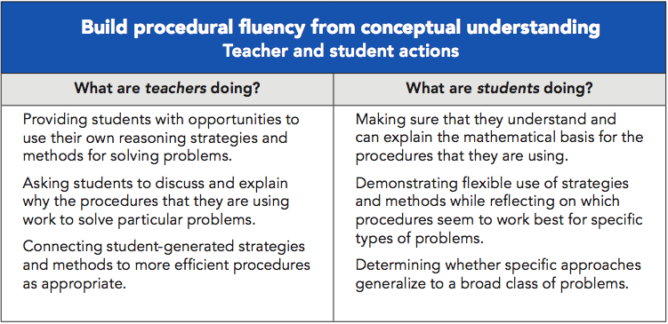

Slide 29
Eight High-Leverage
Instructional Practices
Support Productive Struggle in Learning Mathematics.
Effective teaching of mathematics consistently provides students, individually and collectively, with opportunities and supports to engage in productive struggle as they grapple with mathematical ideas and relationships.

Slide 30
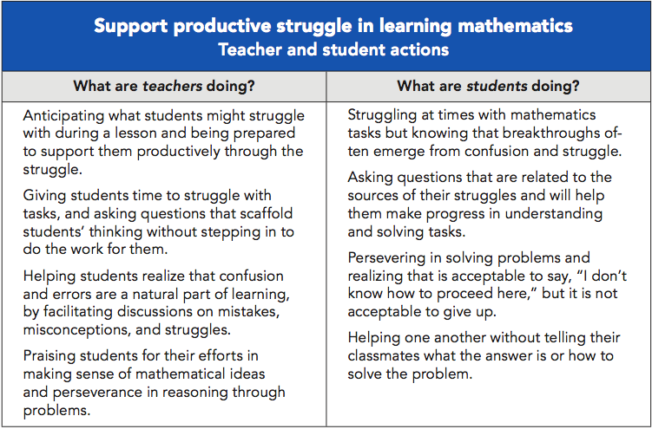

Slide 31
Eight Research-Informed
Instructional Practices
Elicit and use evidence of student thinking.
Effective teaching of mathematics uses evidence of student thinking to assess progress toward mathematical understanding and to adjust instruction continually in ways that support and extend learning.

Slide 32
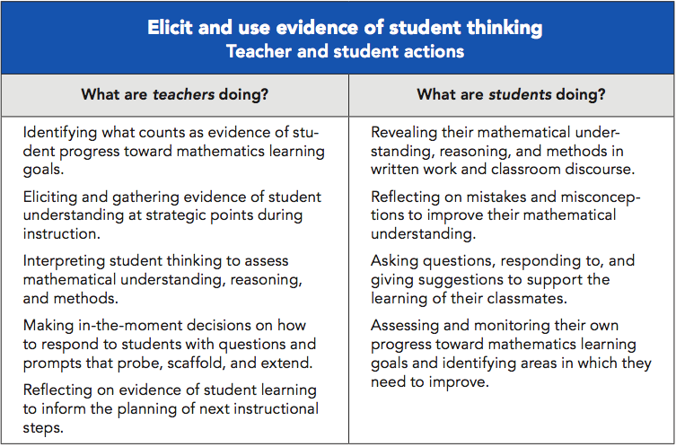

Slide 33
Five Essential Elements of Effective Mathematics Programs
Effective teaching and learning, while the non-negotiable core of successful mathematics programs, are part of a system of essential elements of excellent mathematics programs.

Slide 34
Five Essential Elements of Effective Mathematics Programs
Access and Equity
Curriculum
Tools and Technology
Assessment
Professionalism

Slide 35
Guiding Principles
for School Mathematics: Curriculum
Curriculum
An excellent mathematics program includes curriculum that develops important mathematics along coherent learning progressions and develops connections among areas of mathematical study and between mathematics and the real world.

Slide 36
Curriculum Obstacle
Grade level mathematics curriculum standards are often treated as a checklist of topics. When conceptualized as such, mathematics content becomes nothing more than a set of isolated skills, often without a mathematical or real-world context and disconnected from related topics.

Slide 37
Guiding Principles
for School Mathematics: Assessment
Assessment
An excellent mathematics program ensures that assessment is an integral part of instruction … and informs feedback to students, instructional decisions, and program improvement.

Slide 38
Assessment Obstacle
Traditionally assessment tends to emphasize the evaluation of student achievement (e.g., assigning grades), and more recently, the rating of schools and the performance of teachers – the cultural perception that links assessment to grading and rating …

Slide 39
Teacher Action Steps
to Support the Assessment Principle
Work in collaborative teams, grade level or subject-based, to develop common assessments that will be used formatively, commit to their use, and use the results to advance student learning and improve instruction.

Slide 40
Guiding Principles for School Mathematics: Access and Equity
Access and Equity
An excellent mathematics program requires that all students have access to high-quality mathematics curriculum, effective teaching and learning, high expectations, and the support and resources needed to maximize their learning potential.

Slide 41
Guiding Principles for School Mathematics: Tools and Technology
Tools and Technology
An excellent mathematics program integrates the use of mathematical tools and technology as essential resources to help students learn and make sense of mathematical ideas, reason mathematically, and communicate their mathematical thinking.

Slide 42
Obstacles to Tools and Technology
Often students do not actually engage with technologies or tools in ways that promote mathematical reasoning and sense making. Having students watch a computer presentation or tutorial in which mathematical facts and examples appear, no matter how visually engaging, is not significantly different from having students watch a teacher write the same information on a white board.

Slide 43
Guiding Principles for School Mathematics: Professionalism
Professionalism
In an excellent mathematics program, educators hold themselves and their colleagues accountable for the mathematical success of every student and for their personal and collective professional growth toward effective teaching and learning of mathematics.

Slide 44
Professionalism Obstacle
In too many schools, professional isolation severely undermines attempts to significantly increase professional collaboration … some teachers actually embrace the norms of isolation and autonomy. A danger in isolation is that it can lead to teachers developing inconsistencies in their practice that in turn can create inequities in student learning.

Slide 45
Collaboration Should Include
An examination and prioritization of the mathematics content and mathematics practices students are to learn.
The development and use of common assessments to determine if students have learned the agreed-on content and related mathematical practices.
The use of data to drive continuous reflection and instructional decisions.

Slide 46
Collaboration Should Include
The setting of both long-term and short-term instructional goals.
Development of action plans to implement when students demonstrate they have or have not attained the standards.
Discussion, selection, and implementation of common research-informed instructional strategies and plans.

Slide 47
Start Small, Build Momentum,
and Persevere
The process of creating a new cultural norm characterized by professional collaboration, openness of practice, and continual learning and improvement can begin with a single team of grade-level or subject-based mathematics teachers making the commitment to collaborate on a single lesson plan.

Slide 48
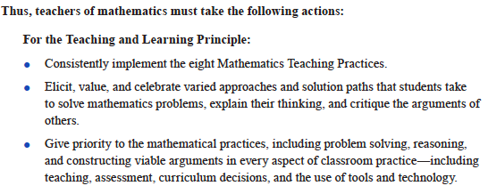
The Title Is Principles to Actions

Slide 49
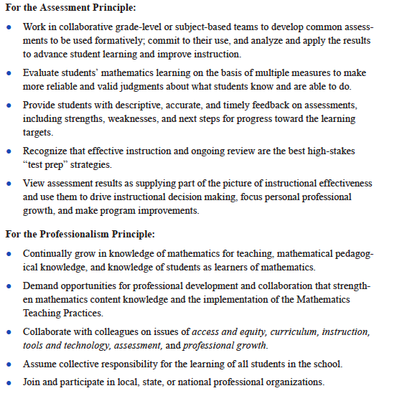
The Title is Principles to Actions

Slide 50
Guiding Principles
for School Mathematics
1. Teaching and Learning
2. Access and Equity
3. Curriculum
4. Tools and Technology
5. Assessment
6. Professionalism

Slide 51
Principles to Actions:
Ensuring Mathematical Success for All
The primary purpose of Principles to Actions is to fill the gap between the adoption of rigorous standards and the enactment of practices, policies, programs, and actions required for successful implementation of those standards.
NCTM. (2014). Principles to Actions: Ensuring Mathematical Success for All. Reston, VA: NCTM.

Slide 53
Alternate template
Principles to Actions:
Ensuring Mathematical Success for All
  Describes the supportive conditions, structures, and policies required to give all students the power of mathematics
  Focuses on teaching and learning
  Engages students in mathematical thinking
  How to ensure that mathematics achievement is maximized for every student
  Not specific to any standards; it’s universal

